Slide 1
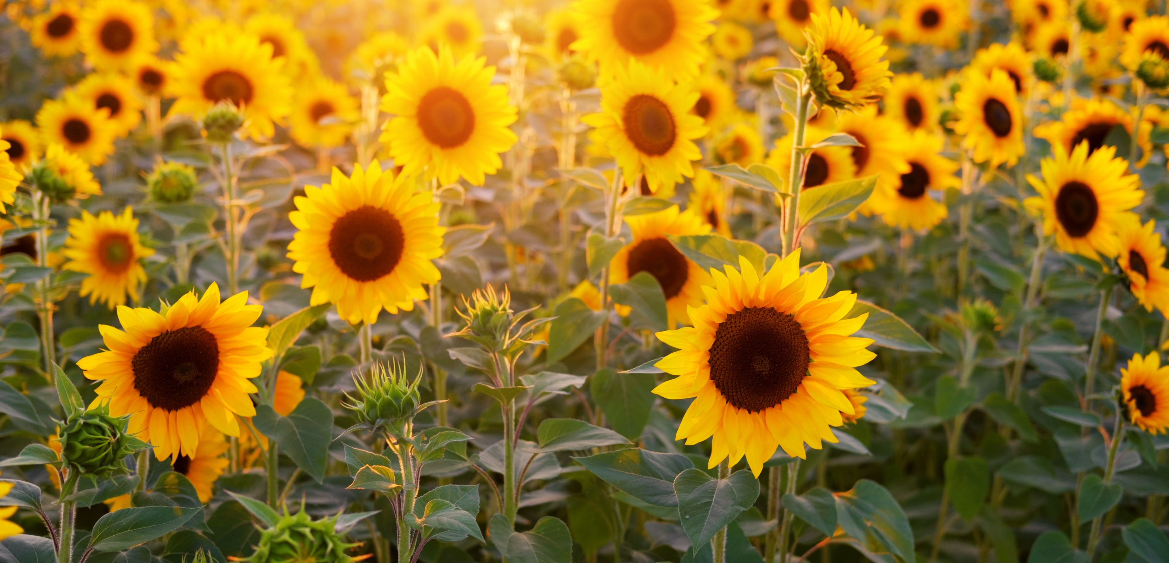

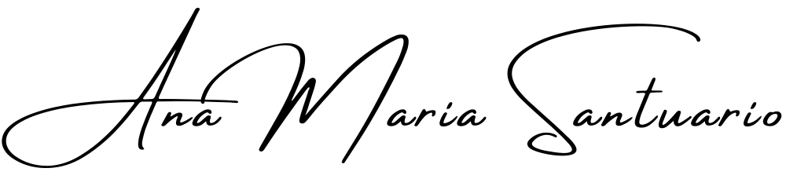
A Healthy Life 101
The Self-Inquiry Series, with,
Our definition of health has morphed into something unattainable as a constant; let’s begin your journey of self-inquiry by looking at what it really means to be healthy in this day and age, with regard to both mind and body.
Workshop 001 of the series, Self-Inquiry for the Modern Age.
https://anamaria.org/self-inquiry-for-the-modern-age/ ©Ana Maria Santuario 2023.

Slide 2

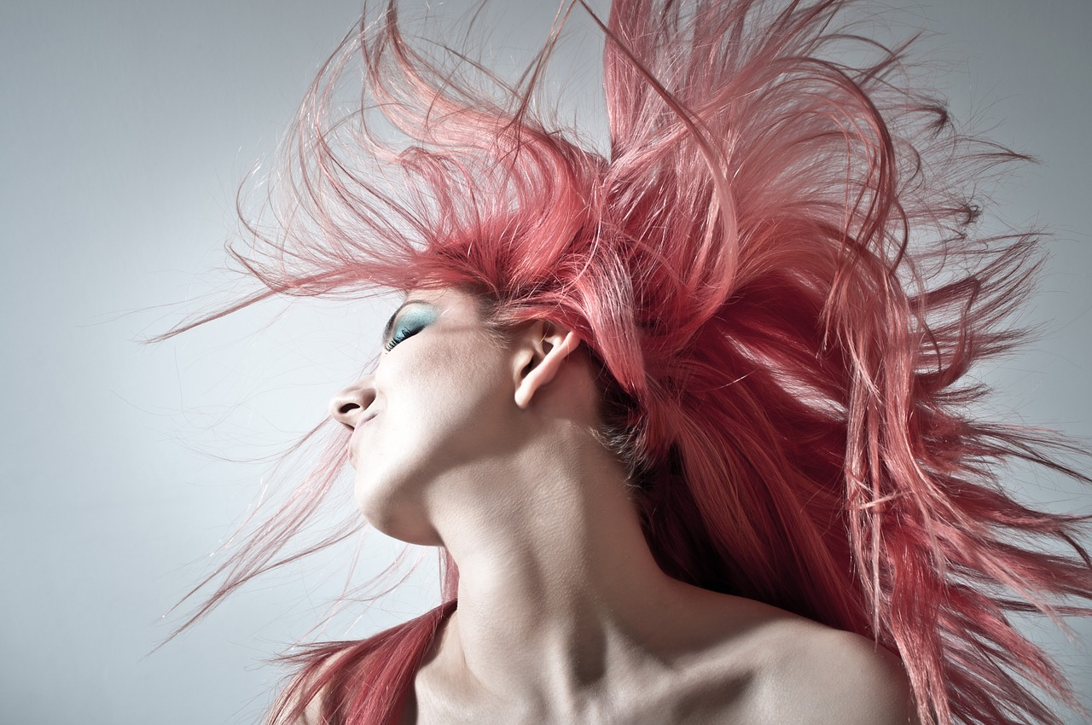

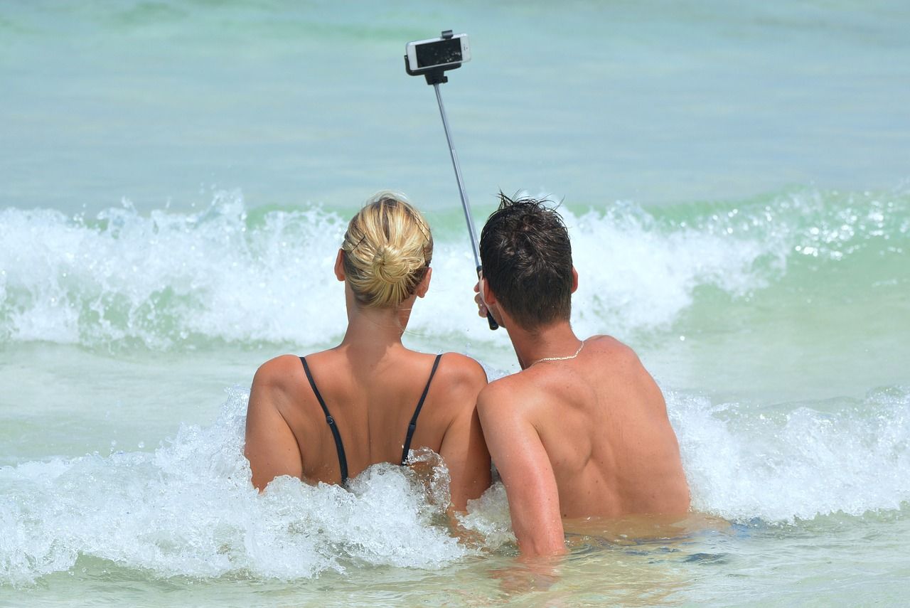
Contagions
Time was a contagion generally referred to a poison or toxin easily ingested or absorbed form the atmosphere around you that would cause ill health and perhaps even death.
We have a new contagion today – SOCIAL MEDIA & POPULAR CULTURE!
I am awesome!
My honeymoon was great – look!
Let’s get on it!
Look at me…
Having no fear of addiction is a worry!
© Ana Maria Santuario

Slide 3
PROTECT YOURSELF (caution – triggering possible)
Any Self-Care practice must first begin with making yourself safe and sound enough to take required actions. When you are perpetually unsafe in mind and body it can be hard to thrive as a rule, not an absolute rule, but as a general pattern quite predictable in nature.
Take an abusive environment as an example – many of those women/men/children, will not even become aware of this dynamic until it’s made clear to them, either by divine intervention, or that of a friend or service provider – neither of the latter made likely by the restraints we are all under in supporting those in need (Governments make it so hard to help – a topic for another time and place).
Please know that it is your responsibility to remove yourself from an unsafe environment, please do it systematically and ask for help from the right people – they ARE out there, just waiting for you to reach out. And where they aren’t available to you, become your own saviour and get out of any place that is not safe. It may take years, but with a little faith, planning and focus you will achieve your end game – change.
© Ana Maria Santuario

Slide 4
Staying Safe
To know whether you’re safe or not means you must have already experienced the feeling, there must be a reference from which to work. If you have never felt safe and this is your normal, how will you ever know?
A good exercise is to go into nature and surround yourself with birdsong, light and a gentle breeze… even the rain will do it. Nature never ails you; it only shows you what you already are deep within – safe.
I cannot tell you whether you are safe or not, or even what this may look like for you personally, it will all be relative and potentially relational. all I can do is tell you what is not safe for me… So here goes…
© Ana Maria Santuario

Slide 5
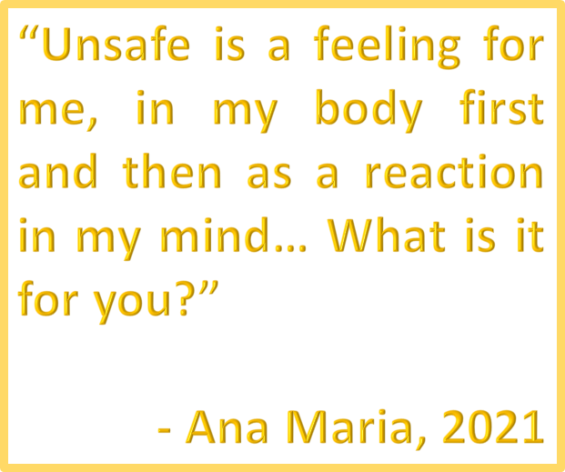
My Unsafe is…
A loud environment with too much rage around me. Angry people harsh my mellow. This includes loaded topics such as politics, global economics and food crises. Things horrifying that I cannot change (i.e. anything on the news).
A powerfully violent movie with gruesome details – I definitely do not need that in my life.
An advertisement in the public arena of a horror movie – why does the world insist on inserting this horrid image into my psyche? How dare they! (remember, your children will be exposed to this as well, sadly they are left unprotected in an uncensored world).
A word in a song that triggers a memory of sadness, these days I prefer lyric-less music, something I’ll expand on later…
© Ana Maria Santuario

Slide 6
My Unsafe Continued…
Particular people make me unhappy – they are not safe.
Someone who gossips about others is obviously going to do this about me – they are not safe!
Someone who shouts at me for having an opinion – they are not safe!
Someone who hurts me physically – they are not safe!
Someone who doesn’t let me express my voice – they are not safe!
You get the gist – anyone who devalues your worth or intentionally causes you pain and suffering are NEVER safe for you!
Note: This doesn’t always mean that they are a person to avoid, perhaps just one to set healthy boundaries with (watch out online for the new ‘Boundary Setting – A Practical Approach!’ seminar). Although sometimes it means – AVOID THEM!
© Ana Maria Santuario

Slide 7
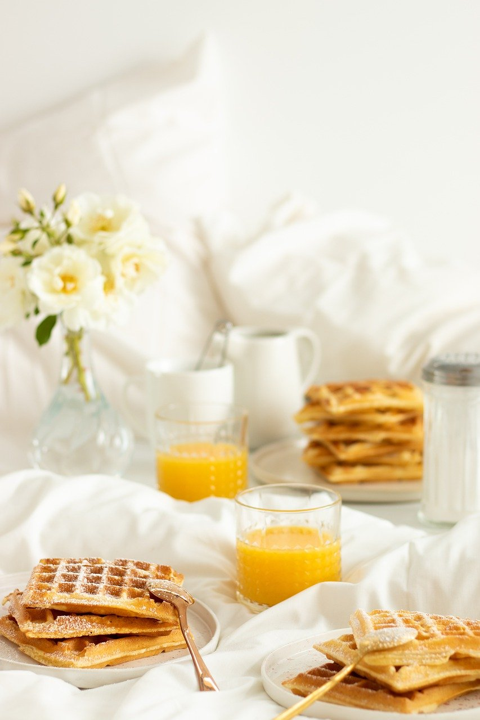
Things that make me feel safer…
Being alone and in bed with a pillow down my spine – makes my body rest in a new way (something to hug doesn’t hurt either – cuddly toy, comfort blanket, small cushion).
Having a perfect bath, with lavender, peppermint and lemon oils – throw in some Epsom salts and I am all stretched out without trying.
A healthy diet heals my body and helps me to like myself more.
I like to watch ‘safe television’ – a new concept for me. Things that lift my light and spirit… not drown me in sorrow and pain.
Not going out the house – in moderation, although sometimes becoming a hermit for a time plays a role in recovery processes. Staying safe can mean being okay with being alone.
© Ana Maria Santuario

Slide 8
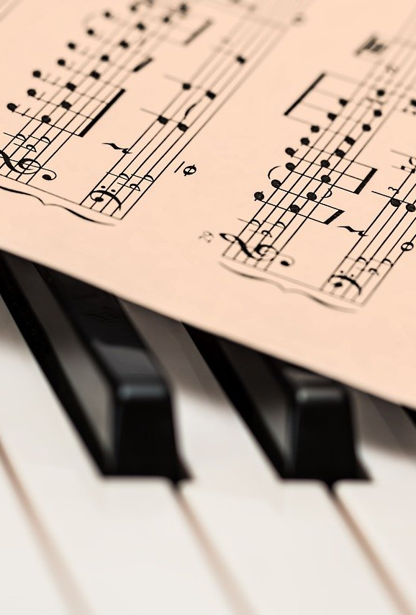
Things that make me feel safer… continued!
I listen to music without words. Lyrics trigger memories I’d rather not recall. It seems to regulate my life better since I get to ‘choose’ what I feel, rather than be a victim of a sad love song or words about the death of a loved one which come to trigger me unexpectedly into a state of grief as I drive home. I am a sensitive soul and I own it!
I protect myself from negative energy sources. These can be sound based, such as powerful words from another human, or a story I don’t want to hear (I hate how humans repeat tragedies like gossip – like mini-news feeds, social media is a crime against humanity in this regard – TOXICITY CENTRAL!).
I never pretend to like something that I do not care for anymore to spare the feelings of another.
© Ana Maria Santuario

Slide 9
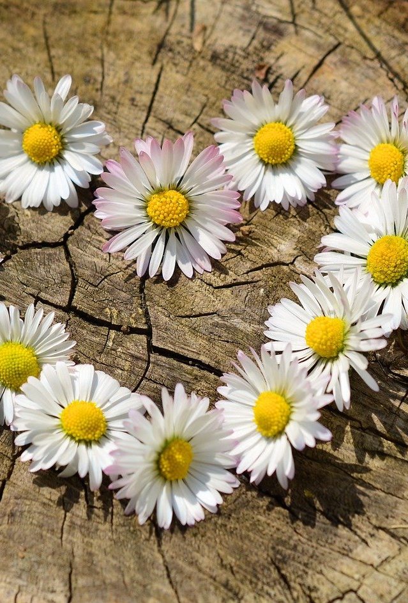
Things that make me feel safer… Last one…
I do not eat a meal somebody cooks when I don’t like the taste. I’m not impolite, but I’m allowed to not like things.
I like to say no – it empowers me to own my world and life and take responsibility for myself in a new and fabulously powerful way! If ‘they’ don’t like it, well, they can suck it because this is me now! And those who are meant to end up sticking around.
I communicate clear boundaries, when necessary, and am always polite and gracious, yet others still react, and I decide not to own it. I let their reaction be theirs and take no responsibility for it any longer. It is beyond my parameter of control… most things are…
© Ana Maria Santuario

Slide 10
WE ARE WHAT WE ABSORB
The world is made of energy, what energy do you take in via your senses?
© Ana Maria Santuario

Slide 11
Think about it… Life is what you MAKE it!
Life, up to now, has been a thing of receipt. You’re born to a part of the world, adopt their culture and mindset by way of growing up ‘naturally’ within a community, as all children do, then become just like those around you… for the most part, there’s always a black sheep or two – different and therefore strange.
To conform has meant survival for a long time – even to survive your schooling likely took some conformity… and work… and friendship…
BUT WAIT! Now we have the internet and movie culture, not to mention games that suck your attention outward and draw you into a new and stimulating world. Magazines telling you what to wear, what to eat and how to spend your days. Are we even really learning how to live anymore, or just mindlessly following a mass cult that spend their days confused and constantly altering their mind-set because of new trends and fashions every few years. Just look at the new iPhone each year. Life moves faster now!
WHAT IS REAL? WHAT IS NORMAL? WHO EVEN ARE WE ANYMORE? DID YOU CHOOSE TO BE YOU OR WERE YOU PROGRAMMED THIS WAY BY THE WORLD AROUND YOU?
© Ana Maria Santuario

Slide 12
Normal is a relative term… (potentially triggering topic)
Normal is what you’re raised on; having an abusive parent can mean normalising such things and becoming an abused spouse. Are you ever actually abused or just repeating a pattern? Who is to blame? The husband who is being himself, an angry man, or you, as you constantly allow him to be what he is, all while complaining about it? Or is your narcissist mother to blame, or the father who beat your husband? What about the spouses who stood idly by and watched it all go down? Who is to blame? No one really. We live generational patterns on repeat, mindlessly reliving some variation of the energetic experience we were raised on.
These are all questions far too complicated for a short answer, yet worth contemplating if you feel that to do so would benefit you or perhaps someone that you know and love.
What is normal has no definable term as an answer, it is interchangeable, through time and space its relative definition has evolved to no end and is now a moot term, since nothing will ever be ‘normal’ again. I think that normal went out the window with technology and fame and glory becoming what pumps this world and its ice cold heart.
Please note: We will talk more about interrupting cycles in an additional session, it requires hard work, diligence and practical solutions to boundary setting. Keep an eye on your inbox for more updates.
© Ana Maria Santuario

Slide 13
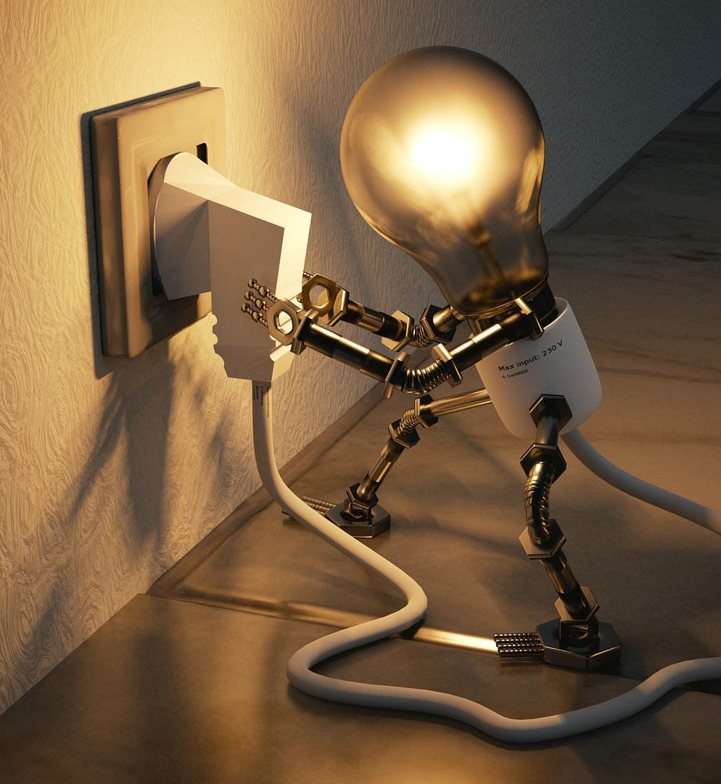
Off Topic?
Now I know you may think me off topic, but to know these things is to know what you are, a person who was programmed in a certain way and who generally repeats the patterns they were raised on until the day they die.
You’re plugged into the life force that drives you, until you unplug yourself, so to speak!
These hard truths are what can wake a person up from perpetual slumber and a repetitive cycle of suffering. They are necessary truths that may just burst your bubble of ignorant bliss, which can result in sameness, monotony and a powerful inability to shift and change your reality and mentality.
The thoughts that you think determine your world, let’s return to this in more depth another time.
© Ana Maria Santuario

Slide 14
Now I did promise this would be about health
What is healthy?
What is unhealthy?
Clear communication.
Safe and protected boundaries.
A noise-o-meter – i.e. the sounds you absorb do impact you!
Visual peace and beauty.
True friends and family, those who see, value and nurture you.
A caring approach towards your body and mind.
Saying NO! But also yes to support when you need it.
Violent behaviour.
Rage outbursts.
Addictive patterns and cycles, including drugs, shopping, food and other ‘vices’.
Strong tendency to isolate.
People who harm you, devalue you and lower your sense of self worth.
Constantly feeling sad and alone.
Never putting your own needs first.
Always taking care of other people first.
These are only thoughts to get you thinking, the list is not extensive and is merely to provoke contemplation and self reflection. More on these aspects of life in later webinars to come.
© Ana Maria Santuario

Slide 15

WHAT ABOUT FOOD?
For a long time ‘Health and Fitness’ has focused, to the detriment of mental health, on a body image, one unattainable without sacrifice.
We, at The Ana Maria Foundation, see health as a lifestyle focused pursuit, not simply a physical endeavor.
© Ana Maria Santuario

Slide 16
Health is a life lived in balance and harmony.
What does balance mean?
It means eating that piece of delectable chocolate cake, but not everyday. It means eating it and then not immediately running for your life, as though your calorie intake must determine your next punishable thoughts and actions.
It means eating the damn thing and enjoying every delicious bite before sitting with a nice cup of tea and watching a film with a loved one.
Balance means life in harmony with itself. It means there is no payment plan for your pursuits and endeavours, and there’s sure as heck no bill for enjoying a moment of life – guilt free!
© Ana Maria Santuario

Slide 17
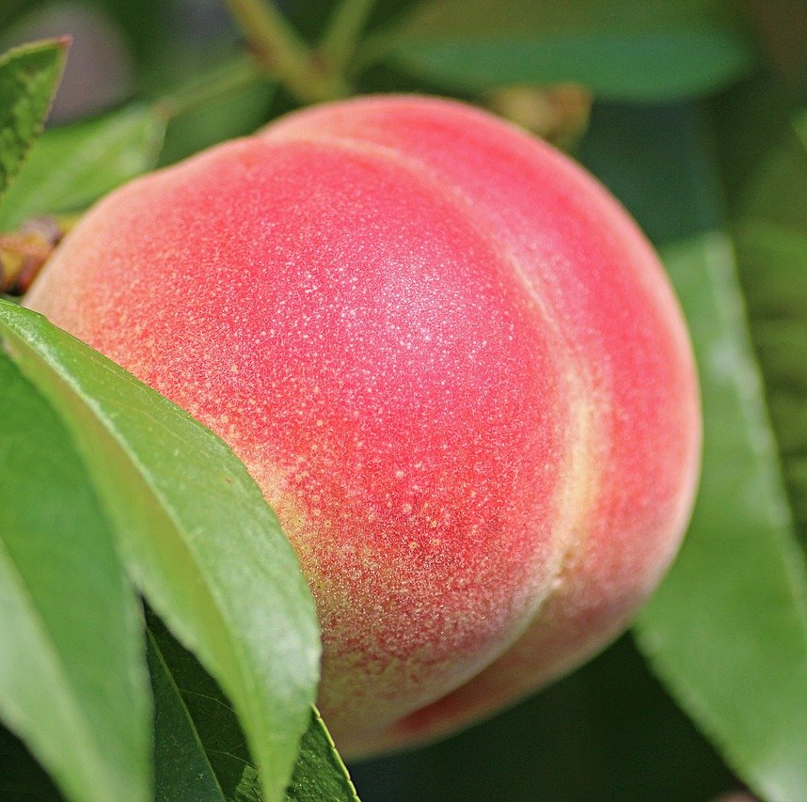
But what about my BUTT?!
I can promise you this, your butt likes cake, it gets a jiggle out of it, a light floating feeling of not being toned to perfection and worried about when it’s not that illusionary ideal of form or shape. Your butt likes cake and so, most likely, do you! You were just programmed to think it unhealthy and so demonised it as a cardinal sin of a healthy diet and life. A little wobble in your derrière is something beautifully soft to the touch and incredibly feminine. Never doubt the perfection of this part of your body, trust me, any partner will enjoy it too!
© Ana Maria Santuario

Slide 18
So when it comes to food?
Healthy
Unhealthy
Eat a diet you enjoy.
Re-learn a feeling of fullness (if you overeat, it’s likely that you eat too fast or have numbed the signals being sent to your brain and your ‘computer’ needs re-jigging and reminding of what fullness feels like).
Make food from scratch – enjoy the process, enjoy the pleasure of it. Life is no chore unless you make it so.
Batch cook – your freezer is your friend.
Anything in excess – ANYTHING!!! Even too much water does your body harm (yes, overhydration is a thing).
Sugars, sweet treats and other processed foods are ADDICTIVE. It is not you being greedy, it is chemical compounds designed to make you overeat and spend more money (make your own treats and find that you enjoy sweets without needing more when they are made with love and a compassion for yourself).
© Ana Maria Santuario

Slide 19
So when it comes to food? Continued…
Healthy
Unhealthy
Smoothies changed my life, they can yours too – easy nutrition.
Quality and high-dosage vitamin therapy can heal/manage complex ailments such as depression, alcoholism and even schizophrenia. Please visit the reference and reading section @ anamaria.org to find the related texts.
Juicing can become your best treatment for many things, as can high levels of nutrition taken in other various forms.
All fad diets are a temporary solution to a real and potentially deeper issue you need to look at within yourself.
Picking at things (mindless eating), rushing your meals, instead of gratefully sitting down to eat with thanks.
Loading junky chemicals into your system… all processed foods contain things unnatural and hold an emptiness not meant to be ingested, digested, and absorbed into your body – there WILL be consequences to such a diet in the long run.
p.s. If you have children please think about the model behaviours you’re displaying – they WILL learn directly from you and their lifelong health and safety is YOUR responsibility. Not the governments, not the schools, YOURS!
© Ana Maria Santuario

Slide 20
BEING GRATEFUL FOR YOUR PLATE…
A prayer can remind us what it is to eat and to say thanks for the life that it provides…
May heaven bless this nutritious feast with love and the compassionate filling of my stomach. May mother earth’s energy be felt and received as a beautiful experience to follow. I am thankful for this energy which may sustain my passions, life and a graceful endeavour to live this life as it was designed to be… in love with myself and those around me. Amen.
Find more prayers at https://anamaria.org/prayer/
© Ana Maria Santuario

Slide 21
Don’t forget to move!
I won’t go into this much now since it is time to leave you with your own thoughts and reflections and I have much to say about movement and what this world has turned it into… a punishing regime to upkeep the otherwise unattainable.
Please press pause on your life if you do this to yourself… go for a walk, see a flower in bloom, have a swim in nature’s waters rather than a chlorine filled shared bathtub.
Enjoy the world by moving around it… this is my movement motto. Stretching never hurts either, nor does a good old dance sesh in the bedroom. Whatever you enjoy is what matters most.
© Ana Maria Santuario

Slide 22
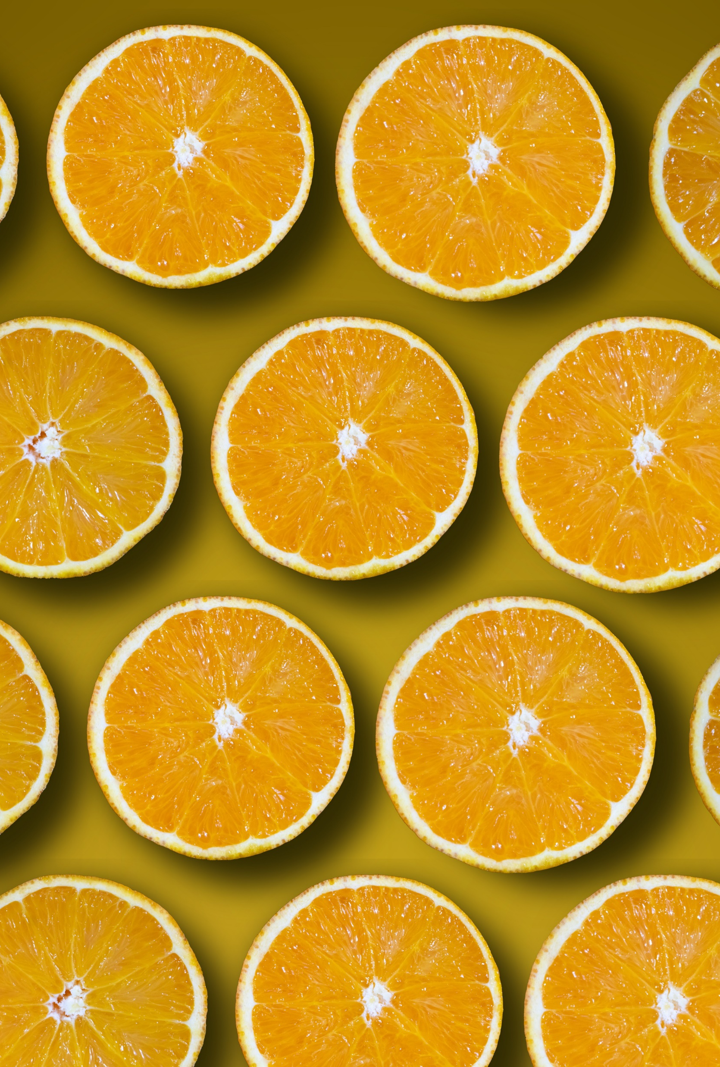
KEEP FAITH
There is a reason you react, eat a certain way, distract yourself with vices, it’s called programming and patterns, and we all seek to resolve our one life with the wrong things. Ana Maria spent her life endeavouring to solve the problem of her suffering, of her perpetual loops and cycles. She learned you cannot rid yourself of everything entirely, but you may just learn to live well with every piece of you becoming apparent within your own awareness; perhaps you might even live expansively and with a new energy that allows for permanent and sustainable change. Food alone may change your life. Please have hope for yourself and those around you that change is always possible… with a little FAITH!
© Ana Maria Santuario

Slide 23
Here you will find a link to a workbook that pairs with this Power Point series, it guides you further inward and offers the chance to complete exercises as you work through this series of Self-Inquiry for the Modern Age.
TO AID YOU ON YOUR WAY…
Please see the Self-Help Library for inspiration, tips and practical solutions to anything that arose from your reflections today. You will also find more from the series of Self-Inquiry for the Modern Age. Dissecting and decoding what makes you, you, is all self-inquiry is truly about… this is a lifestyle metamorphosis, one potentially taking years, not a destination course. With this session you will have found threads that, when pulled, lead you inwards, which is the only place one may seek with any long lasting result of change in feeling, appearance, and ultimately, design of the self.
Workshop 001 of the series, Self-Inquiry for the Modern Age. https://anamaria.org/self-inquiry-for-the-modern-age/ ©Ana Maria Santuario 2023.

