Slide 1
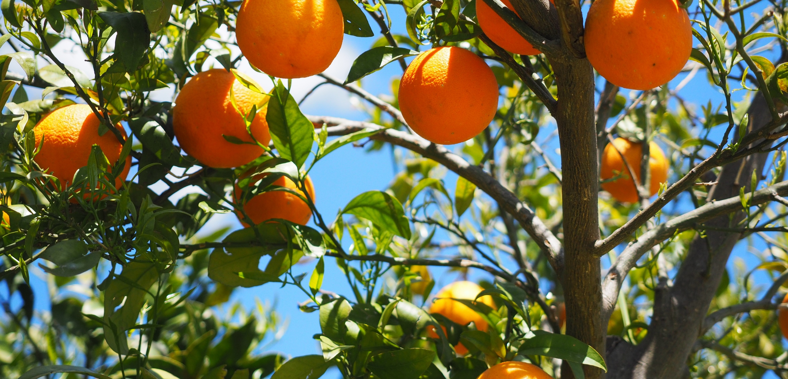

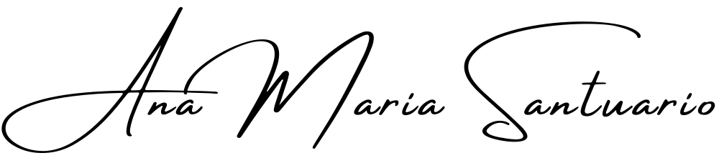
Setting Boundaries
The Self-Inquiry Series, with,
Making yourself safe always requires the setting of healthy boundaries… But what are healthy boundaries and where do you begin?
Workshop 003 of the series, Self-Inquiry for the Modern Age.
https://anamaria.org/self-inquiry-for-the-modern-age/ ©Ana Maria Santuario 2023.

Slide 2
There’s a reason you feel so ashamed!
In life we are raised to say our pleases and than yous – it’s polite, right? But what about when you’re thanking someone for a thing you really didn’t want or need? Is it then a lie? Are you feigning thanks? Or is your politeness received well and pleasing to their ego?
What even are manners anyway? A thing we do to please this life on earth and make it harmonic to others? Or a thing we do to make ourselves seem nicer?
I’ve met terrible people with nice manners, and horridly mannered people with hearts of treasured gold. Are manners the ultimate illusion?
Who made up all the rules? Who said we had to become these robotic structures of self and play a game that was already set to be nothing like what comes naturally to us as human beings.
© Ana Maria Santuario

Slide 3
Don’t get me wrong…
I am a sweetly mannered person, but to my own detriment. My people pleasing nature has left me invisible in life. My needs went unseen by other people, and remained unknown even to me, and this has caused me a great invisible pain in life.
Saying yes because it was polite left me unable to say no, even when I wanted to…
Having casual sex was a no-go, wasn’t polite or lady-like, and I liked being a lady, even a young one. But that means I never fit in… and ended up perpetually single. I wanted a Mr Darcy style romance, a thing of novella and traditional literature.
It seems many a relationship now is born from drunken casual sex; or a work place romance; an internet date born from two folks seeking love; or a probable long time connection among friends or casual acquaintances.
Don’t get me wrong, I always knew this would be my world for a time – alone. No one gets me, no one sees me… all because of my invisible boundaries. Alas, only a rare few see through the exterior to within a person. Let’s call it love.
© Ana Maria Santuario

Slide 4
Don’t get you wrong…
I am not a judgmental person, let’s make this clear now. If you react to something I say it’s because you have issues that are provoked out into the open. Look at them, get to know them, and know that they are a part of you. This boundary setting business is a meaty topic and is sure to become a great lesson, but it’s essential to get to know yourself first.
Who are you, what role do you play in this world around you? Are you the yes-man? The world adventurer? The perpetually single gal? Whatever you became was a cumulative result of your soul essence mixed up with your energetic experiences of life… and it gave you boundaries – rigid ones, flexible ones, seemingly non-existent ones. Some are related to your internally held levels self-value and self-worth, others were lessons life taught you. But rest assured, you all have boundaries.
Your boundaries may well be unknown to you, and let’s face it, many boundaries we ‘emit’ are invisible. Body language psychology accounts for these invisible boundaries. As an example, a younger specimen, say a 15 year old, is an easier target for a scam; a girl or boy with less experience in life may present as an easy hustle, perhaps easily manipulated by a marketplace salesman in London, or Thailand, or Colombia (hustlers exist all around you). A con artist (or sales person) is designed to see a customer and play a game… and when they see some individuals their inner radar immediately, resoundingly, screams, ‘Yes! Cha-ching! There be some easy money to make this afternoon!’
Another salesman, with healthier boundaries, may see them and say, ‘Hey, don’t pay that much, there’re robbing you blind.’ Boundaries work in all directions, they not only keep yourself safe from harm, but others too. Collective boundaries are what we once called a community, I think.
© Ana Maria Santuario

Slide 5
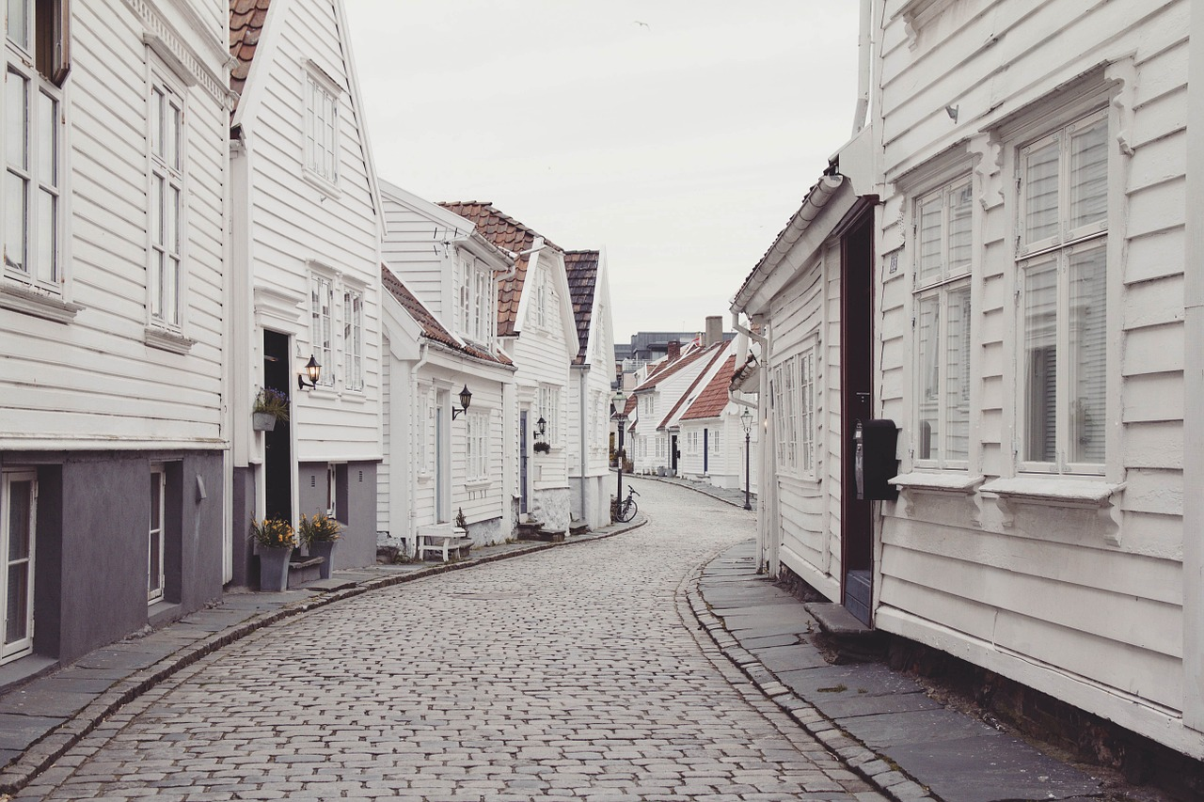
“As the world becomes more me and less we, there is change, powerful shifts in psyche, community and togetherness. Together now means a cause, something to stand for, whereas before it meant sharing food, water and shelter. Our definitions of community have changed, as have we, right along side them.”
- Ana Maria, 2021
© Ana Maria Santuario

Slide 6
Don’t get you wrong…
If I told you my views on tinder; how when I sat with my army friends and watched them swipe ladies faces, left, right, left, “What a troll”, left, “Bags that one”, right, left again… if you knew how they spoke about your womanhood; ‘Nailed it!’ ‘Smashed it!’ ‘No, had her already!’ ‘Just need to flip that one over and not look at her face’. Would you still put your face on there? I never did and never will. It is not a thing I wish for, men to speak of me in such disrespectful ways.
If you decide that you’re angry at me for pointing out that an internet date equates to the seeking of love, check out your internal radar and ask yourself, if indeed you do go out on many an internet date, what are you looking for that you need, want or desire. Of course many are looking for sex, but having watched my male mates swipe women’s faces and smugly increase their likelihood of getting laid that week – I thoroughly decided a long while ago that my hole was not any man’s goal!!!!
Ladies – brush up on your dignity, swear allegiance to your womanhood and stop letting men take advantage of your need for love, affection and romance. You are so easily manipulated, I’ve watched it happen again and again… and again.
Men are pragmatic (most of the time) they know what they want, try to get it, when they don’t they walk away, head held high. Of course this is the mask that they wear, of course they will seemingly have feelings and reactions too – but not like yours or mine! Not as emotionally connected to sex (biologically), they can leave you in bed and never look back, all whilst you pine and wait for the text that never comes, or better yet, the phone call asking you out on a REAL date. Become a woo-able woman!!!
© Ana Maria Santuario

Slide 7

“BE BRAVE ENOUGH TO KNOW YOUR VALUE AND WORTH, AND TO KNOW THAT THE RIGHT GUY/GAL DOESN’T F*** YOU AND THEN WALK AWAY OVERNIGHT! THE RIGHT PERSON WILL VALUE YOU ENOUGH TO INVEST!!!!”
- Ana Maria, 2021.
© Ana Maria Santuario

Slide 8
Don’t get you wrong…
As for the men, let’s get it right – you’re enjoying yourself, right? Having a great time? I get it and I commend it. Don’t feel bad about what you are at times, a heat seeking missile! Enjoy it while it lasts before the Ol’ Ball and Chain comes about, right?
These woman need to know themselves before trying to commit to you. They need to learn that emotional connection occurs as a result of sex and to expect it, but not to expect it from you.
But you do not get to call them crazy, or demonised, when they react badly to your lack of respectful behaviour. ‘Ghosting’, a new terminology for a slap in the egoic face of a casual relationship, is a cowards way of treating a whole and feeling human being like garbage you threw away because you were ‘done with it’.
You may not know what to do or say, nor understand why a girl who likes/loves you cannot fathom your cold heart… but handling it is easy: ‘I’m sorry, but this isn’t what I wanted. I enjoyed your mind and body for a time, but now I regret to inform you that it was nothing more than a casual encounter to me.’ It will hurt, but be brave, be brutally honest and then walk away. Don’t tease, don’t try to be too nice about it either. Girl’s cling to nice like there’s a shot of hope attached to it. They read into your behaviour like a dog reads into a cat’s paw prints left in the mud.
Let them go… with the dignity they are deserving of. Now that ‘equality’ deems it necessary for casual sex to determine a woman’s equality to a man’s, it seems there’s no going back to asking for daddy’s permission – but was this tribal instinct based in a knowing of what lies under the mask of a man in heat?
© Ana Maria Santuario

Slide 9
When somebody makes you feel bad!
When somebody makes you feel bad, stop letting them! Easy, right?
WRONG! When you have a perpetual cycle of wrong people coming back into your world, you are struggling with something deeper, something attachment theories will help you to decipher. There is a need for you to learn about why you allow such things to happen to you on a recurring basis! Look into it, you deserve more!
Are you an emotional wreck? Is there a person playing with your heart and mind? Are they a safe individual or are they working you to their own enjoyment? Are they nasty and cruel with words; or lifting your sense of value and reading insightfully into what you need and want? Are they learning about you to take advantage of your kind nature; or are they learning about you to take advantage of this prized opportunity to meet an awesome human being who is worthy of investing time, energy and love with?
DANGER! Some people on this earth do not care who you are and WILL destroy your sense of worth and welfare just for their own sick pleasure and intrigue! They will crumble your self esteem because it looks easy to do and they will leave you all alone when they are done with you! This happens in REAL LIFE! I’ve watched it happen to others, and against all odds, ended up with a person abusing me, subtly, enjoyably, and to their own personal gain. It was a shock, a trauma and I lost something in the process, a faith in my own judgement.
Now I am discerning, I let a person’s actions, NOT their words, do the talking.
TALK – ACTION = BULLS**T!
Please use your mind to protect yourselves. LOOK! THINK! And make certain you are SAFE, psychologically, emotionally and physically!
© Ana Maria Santuario

Slide 10
Learning about your boundaries
This takes time, it means reflecting on your world and life; Do you please others to your own loss? Are you able to say no safely and with confidence? Are you always on the receiving end of kindness, such as your boundaries dictate? Were you emotionally abused as a child, normalised it, and now seek out the same illusion of love from other abusive personality types?
This can powerfully end your suffering, when you see what boundaries are and how they really truly impact your wellbeing and sense of safety. Are you safe could be equated to, are your boundaries safe? You are able to stay safe when you become aware of what safety looks like, feels like and how it should be maintained.
Trouble is, what if you were never safe and have idea what to look out for…
© Ana Maria Santuario

Slide 11
Behaviour speaks…
Were you a lonely child? Are you now a lonely adult? Are your walls too high for another to cross into your world of inward reflection and introspection? If so, get to therapy and help yourself to let them in… you deserve love too.
Are you angry all the time? What frightens you so much to push at another until they run away? Anger is a defensive strategy, non-voluntary of course, but it will isolate you and ensure you have other angry people around. Or weak willed people you end up abusing, without this ever becoming, or initially being, your intention.
Relational issues are far more complex than abused vs. abuser. There is an intricate web of self-image problems, self worth concerns and perhaps an entire lack of a core identity and sense of connectedness to self at play here. You are not a nasty or harmful person unless you decide to carry on being that once you are aware of having been it for a while. It’s the change I commend, the intention is enough… just look at becoming familiar with yourself as the best thing there is in life, it only ever empowers you and never weakens your sense of safety. IT IS SCARY, but always worth it, since knowing yourself has happy consequences… change!
Seeing the thing doesn’t mean you’re suddenly changed, just that your perception of yourself shifted and widened to account for more of your wholeness. Acceptance is key, denial equals becoming something like stuck and stagnant.
Change requires you to see yourself honestly and become welcoming of your patterns, perception requires clarity and the right information to inform the story you tell about what you see. If you experience shame and denial, there’s likely a story quite tough to look at. Take your time and be patient with yourself, gentle even… there is no finish line, only an evolution without an end.
There are of course years of therapy going into such self work and reflection for some of us, please seek help when you see something difficult to deal with or face alone. Don’t stay stuck, help shifts perspective and can support any changes you seek. Give yourself time, compassionate understanding and a whole lot of patience.
© Ana Maria Santuario

Slide 12
Reactions talk!
Are you a reaction happening? Most of you are, you know? When was the last time you thought about the answer you were about to give a person in response to a question?
Do you see how you run on autopilot most of the time? Even in an interview, for which you plan to answer some questions, the preparation may train the brain to direct itself towards certain information, the same way it would for a test; but you don’t sit and piece together a response before writing an answer in a test; just as any reply to the interviewer when they ask you what your most powerful occupational lesson has been thus will flow like a river from within you.
How you react can become one of your greatest tells? Are you paranoid and untrusting? Are you uncommonly open to the point of becoming vulnerable and a ‘victim’? Are you really a victim or being yourself and maintaining no awareness of patterns and behaviours that are yours to own?
So long as we point fingers we remain victims, as soon as we own that s**t, we become empowered!
© Ana Maria Santuario

Slide 13
What is safe in human connection?
I am SAFE when…
I am NOT SAFE when…
My voice and opinions are respected.
My value is seen and noted by others.
My heart and feelings are treasured and respectfully acknowledged as worthy of listening to.
My mind noise says this person likes me.
My mind noise says I feel good after spending time with them.
My life feels lighter and healthier with them around.
I smile and laugh lots, but am also allowed to cry when I feel something else.
A person shouts at me a lot.
A person disrespects my voice as less worthy than their own.
A person gaslights me and pretends they haven’t said something that I KNOW they have said.
A person critiques my way of life without offering supportive alternatives and being helpful towards change.
A person disrupts my life with chaos and disturbed thought patterns emerge.
A person physically harms me in a way no one sees, maybe not even me at first.
Note: This list is not extensive, there is plenty more to think about, but this may provoke some thought towards your own safety and sense of self worth and value. Please know that this extends to relationships with partners, friends, as well as, unfortunately, some people’s immediate and/or extended families.
© Ana Maria Santuario

Slide 14
There are ways to stay safe and isolated…
Some of you will know the sorrow that comes with invisible boundaries. Perhaps your heart was hurt so many times you decided to lock it away. Perhaps your childhood trauma prevents anyone getting so close that they can cause your fears to emerge… perhaps your heart doesn’t have space to ‘exist’ and you are numb to feeling anything but rage (p.s. a heart isn’t really a thing, it’s a concept for young romantics to rely on when they are learning how to express their uncontrollable desires and wants – love is what powerfully ignites transformation and sacrifice of self/ego… and love is something you are able to be, not give, do or have. Love is a sense of safety in body and mind and a way of enabling others to reach the same end. Love has nothing to do with heart, and heart is very much a dead concept to me, but for the sake of common agreements of this concept, I’ll have to allow the use of it occasionally).
A loving, kind relationship is something rare and precious. It is when a life is opened into one sense of being – two separate individuals find a harmony in becoming who they were already, just hidden from plane sight. Love is safe, love is kind, love is patient and powerfully transformative when stuck with. Love makes us run from ourselves because love encompasses all your parts and loves everything about you, which requires you come to love everything about yourself too. This means the seeing of oneself, wholly, which can become a challenge in and of itself. It can hurt, tremendously and powerfully. But it is not the love that hurts, it is the scars that it comes to touch upon and heal with light and compassion.
If someone is trying to change you, then they, safe to say, do not love you as you are right now. It’s okay to embrace the need to support a person and enlighten them towards a helpful and healthy option, but not to want to change them at their core, not to reject key aspects of their personality and character. If a person is demanding you change to meet their needs, then they love the projection you provide of themself, they love who you allow them to be when you are shaped into what they desire… perhaps you don’t love yourself enough and so choose to love them instead, perhaps you ended a marriage for them and decide to stick around because another lucky in love situation will not come around. Whatever the reason, you must choose to change for your own self worth, not for the value placed on the change by another.
When you are loved, you are not asked to change, you are held in time and space as you are, appreciated just as you come, and cared for by actively loving moments wherein you become treasured exactly as you present in any given moment.
© Ana Maria Santuario

Slide 15
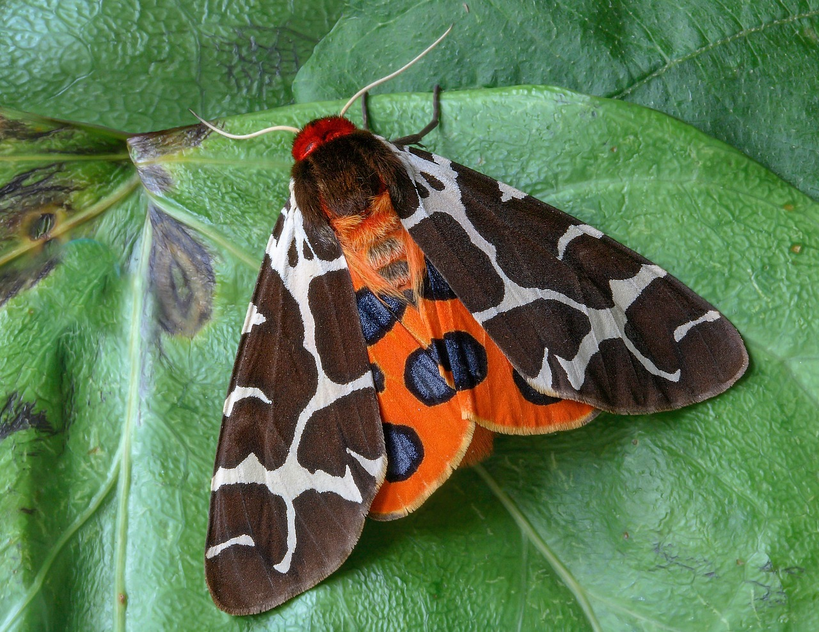
This does not mean…
That you will not argue… love illuminates the lies that we tell ourselves and conflict is a part of growing up… conflict enables shifts and changes, conflict allows an unhealthy reality to become healthy again – or perhaps even for the first time. Conflict is change in motion, it’s just dependent on how you navigate it as to whether your connection will survive it and thrive because of it. Growth can get messy.
I like to think that conflict leads the way to harmony… it is a road one must walk alone within themselves. There can be no playing the part of victim in this game of life, when somebody upsets you, own it, look at what they stirred up within yourself and realise that your reaction is your best guide in life. Your reactions are your best lessons of love and trust and truth.
Although do be wary: your reactions can lie to you – almost always for some of us, since your programming is all set; so, as an example, before you can decide that you want to be loved you may find you've pushed it all away and have nothing left because your fear spoke over your ‘heart’.
You may find that this conflict you threw outwards from yourself became your barrier and ended up creating a conflict that was detrimental to your state of affairs, so much so that it ended something you desperately desired – shared love! You may well be your own worst enemy, not the person sticking around to see if you wake up in time to settle down and have a family together.
What exists within yourself becomes the world around you. Fear of love = no love. Fear of abandonment = likely abandoned, if not physically, then almost certainly emotionally.
There’s a reason we’re here looking at this, trust and bear with me, please…
Underneath an unsightly exterior, we all have beautiful spots…
© Ana Maria Santuario

Slide 16
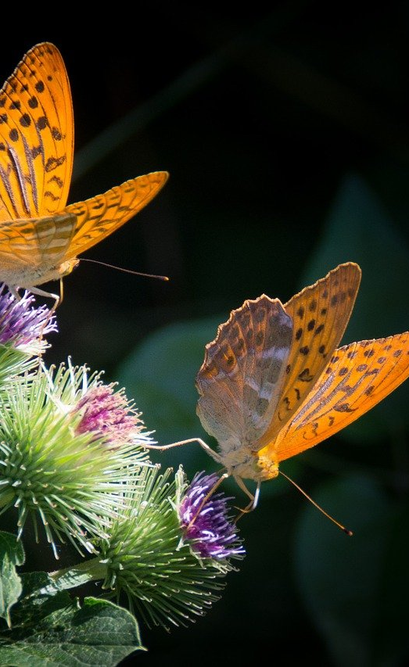
Your better self…
In all of us there is a better self, or rather, a safer self, a person who was unwounded and unharmed by this life they were sent here to live… let’s call each experience lived an energetic occurrence, since we are all up to speed in this day and age, right? You are matter, your vibrating self emits electronic frequencies and exists beyond the physical seen stuff. Your voice is vibration, your heartbeat creates a vibration (the real one – that’s why you can hear it) and you are a sum of all your tiny atomic little parts.
In the world around you, energy flies, moves and zooms (for us lay-people I assume this is enough imagery to lay a foundation for the concept I’m heading towards…).
© Ana Maria Santuario

Slide 17
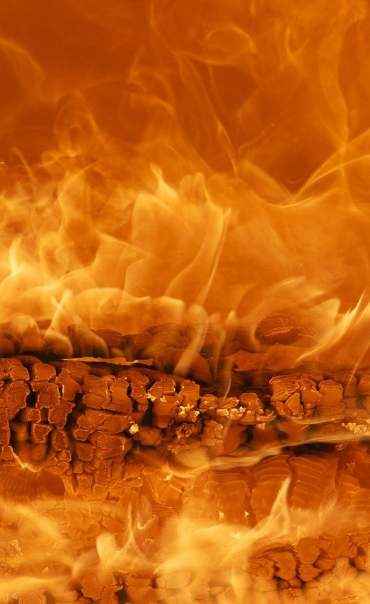
Your better self… continued…
You see, energy happens to us, within us, around us, it is all you see, feel, hear and touch… and when you touch something bad or that harms you, your system updates itself with a new programme integrated as a part of itself…
Let’s say you walk to the bathroom in the dark and stump your toe. Either you switch the light on next time, or walk with a different motion, slower, more cautionary, hands stretched out. You are always meeting your environment in new subconscious/unconscious ways.
Now let’s flip this to romantic notions of love… are you running into things head on, flipping yourself upside down before another person does this in return and meets you as an equal in partnership and connectedness? Are you harming yourself with daydreams and fantasies, all the while ignoring the fact that reality can get harsher than you may ever know or expect?
Are you prepared to fall into the abyss of pain? Would you not rather walk discerningly than keep throwing yourself into the pit of fire only to get burned so much so that you stop taking leaps altogether?
Taking the RIGHT leaps is all I’m recommending, not the wrong one time and time again, only to close yourself off completely… because the subconscious lesson you’re likely reinforcing is that love hurts, no matter how much you love no one will ever love you in return… and you seek to confirm this to yourself with your programmed patterning.
© Ana Maria Santuario

Slide 18
Enter… The Mind
The mind plays tricks on you and the best advice to repeat is…
“LET A PERSON’S ACTIONS, NOT THEIR WORDS, DO THE TALKING…”
- Ana Maria, 2021.
And make sure you’re listening and THINKING about what you see, experience, hear and expect…
Are your thoughts aligned with reality? Is what you’re seeing a projection of your internal wants, needs and desires… or is it REALITY?
© Ana Maria Santuario

Slide 19
Reality checks, of the painful sort!
Reality is easier to avoid than face a lot of the time… it is why people numb, avoid change, choose what is known to suck because it is simply familiar, and it is why people remain unhappy for far too long a time when change is out there, whispering for one to be brave enough to step into it…
Mourning the death of a loved one can be tricky for some and they linger on the edge, doing nothing but prolonging the process of grief. Diving in can be scary, hurt more than you expect, but the only way is through if you want to sit beyond grief and in healing and recovery, ready to form new bonds and open yourself up once again.
Some seek solace in the arms of an unlovable spouse as they end an affair with the partner of their dreams… even having a baby with someone they no longer love since their fear of being seen and loved as they come won out. Therefore, they choose to stay hidden in fear, instead of embracing the love they secretly want and deserve, and reject that which was required to fully connect to themselves and their life purpose!
Inviting in the lie is often comforting on some level since it soothes our inner child and a want and need of love. The illusion is never the solution though, it is the perpetuating of a cycle better left undone in time, time spent with yourself and your mind and body.
Having an affair is never a wrong thing, it’s happening to teach you something important, to inform a choice that needs making… staying in the unhappy marriage is. With obligations, duties and pride all at stake, people take the easy road. To birth a babe into hell is far greater a sin than divorcing at the right time. People cling to what is already rotting, for the unknown can scare even the more courageous of men and women.
Don’t get me wrong, I’m not encouraging affairs, what I am encouraging is a brushing up on your reality and what is actually making you so darn miserable. What are you escaping for the briefest of moments… your own perpetual doom? Your constantly depressed partner who blames you for their misery? Your own disdain of yourself? It’s the reason that matters, not the affair itself! Let it inform you rather than scare you!
© Ana Maria Santuario

Slide 20
Reality checks, continued…
There is a pain to seeing the truth… I watch marriages already in bits being tied together with glue that melts at the flames of reality. I see unhappy married couples harming their kids as they continue kicking on like nothing is wrong. Reality check – maintaining a harmful psychological environment is ALWAYS WRONG for your kids. Don’t let your pride keep you unhappy, because all this will ensure is that your kids learn to do the same!
Boundaries and healthy – two words to transform your world. If a happy you is no longer compatible with an unhappy partner, change it for yourself and your kids! A happier you is ALWAYS better for their self esteem, personal development and self image. They see themselves reflected back in your eyes and smile… they know when it’s not real on a level beyond your awareness… enjoy teaching them to become whole alone, rather than co-dependent in a relationship that is broken and harmful to all, as it sticks to you all like energetic glue each and every day of your life!
Teachable points of interest, aren’t they? You may not be married, you may not have kids, but the morals of these scenarios exist in variety each day of your life… the job that you hate but stick with since you feel nothing else will work out; the harmful friendships which cause you to shy yourself away because these ‘friends’ laugh and poke at your real self; the harmful gossips who burden you with secrets not real and pretend to not do this to you when you’re not around.
Your eyes are better instruments than your ears at times… trust in what you actually see in action as a follow up to words spoken… not what your mind/imagination is telling you – that safe is found in sameness. That safe is where you are at… The realities may be hard to fathom, but they are ALWAYS worth facing, since on the other side of the lie may be a new opportunity to grow, find joy in life and become a better you, one who enjoys your own existence and all it has to offer!
© Ana Maria Santuario

Slide 21

“These moments of transformational realisation are not for everyone, ignorance is bliss, after all. Just make sure your ignorance isn’t the reason you stay harmed by an abuser; in an unhappy marriage; or ignite self-loathing when you watch television alone and eat your weight in sugar. Do not ignore reality when it hurts more than it heals.”
- Ana Maria, 2021.
© Ana Maria Santuario

Slide 22
Lost to Love – A Cautionary Tale…
A woman once loved so much that she’d give everyone what they needed. She thought that all people did this since it was what she learned to do from a young age, be what those around her needed her to be. She called this love. She was loving each person, filling their needs all whilst maintaining a state of invisibility. When she did rise up and find that she had needs, those around her rejected her, since they were so used to getting exactly what they needed from her. This poor girl thought something was wrong with her when all those in her life let her go once she had things that she needed too. They didn’t care when she fell from their good graces, they didn’t care she was left dying in a hole in the ground with no hand to help pull her out. They got on with their lives, finding new and other people to give them exactly what they needed… like children filling their void left over from a lack of love in childhood.
They stole her love and kept it for themselves, as well as her time and energy, without regret, leaving her all alone. Sadly, to know she was loved was all she required to come out from this hole… Unfortunately, she was left for far too long and, learning the hard way, recognised the longer she waited for this love, the longer she sat in a perpetual death of herself. It was a painful place to be, scary too! She rose from the hole by holding her own hands together and praying for the love of life, God and Mother Earth, to fill her up from the inside-out, and lift her effortlessly into the heaven of becoming who she was always supposed to be – her whole self. Her prayers were answered as she committed the rest of her life towards ensuring that people never fell into that same hole in the first place!
The moral of this story is… love yourself well, love yourself first, because when push comes to shove, no one stops to pick you up and you MUST know how to do this for yourself. And so the better advice is… avoid the walk into the holes… know yourself, know your boundaries keep you safe, but also away from thriving experiences. Getting to know who you are is all we’re doing here on this journey of learning and self inquiry… and I hope you see things of value and worth, as well as things open to being changed for the betterment of your health, wellbeing and lifestyle.
Life is long and you have the time to do this, just keep faith that it’s all worth it in the end ☺
© Ana Maria Santuario

Slide 23
What do you notice?
Do you notice that I don’t give too many answers, mostly things to contemplate and ponder.
There are no answers I may give that will be a best fit for you as you are right now… there are billions of people on this earth plane – how can one answer fit all? It never will, which is why I have devised a series of contemplations that bring you internally towards introspection and self-reflection.
You are allowed to think anything that you want right now, no one knows what you’re thinking and although your thoughts may very well cause you harm, it doesn’t mean they must be left alone to do that to you forever. There is a reason for your thinking and the patterns presenting within you. Knowing why can and will help you decipher yourself. But a therapist may be essential in doing this safely. Please stay safe enough and gauge your ability to face your inner world head on and to survive it.
Your thoughts are your internal world manifesting for your own detection and contemplation, this is what meditation asks you to encounter, ‘Watching the thought, never becoming it, just watching it float by like a cloud in the sky.’
Far easier said than done, and to become the thought is often how you realise and then release it. These thoughts are your programming, you will never change yourself entirely, far better to come to know what and who you really are and work from there in building a world around yourself that works for you… not against your energetic flow of personality and individual self-ness.
What I mean to say is, without knowing who you really are and how you operate, you cannot full inform a boundary for anything or anyone. A boundary being set consciously and with thought informing it, this is where we are heading towards this day… and this is only the beginning…
© Ana Maria Santuario

Slide 24
Let yourself go deeper…
More on clear communication strategies and practical approaches to boundary setting in the workshops to come. Subscribe to stay informed @ www.anamaria.org
Workshop 003 of the series, Self-Inquiry for the Modern Age. https://anamaria.org/self-inquiry-for-the-modern-age/ ©Ana Maria Santuario 2023.

