Slide 1
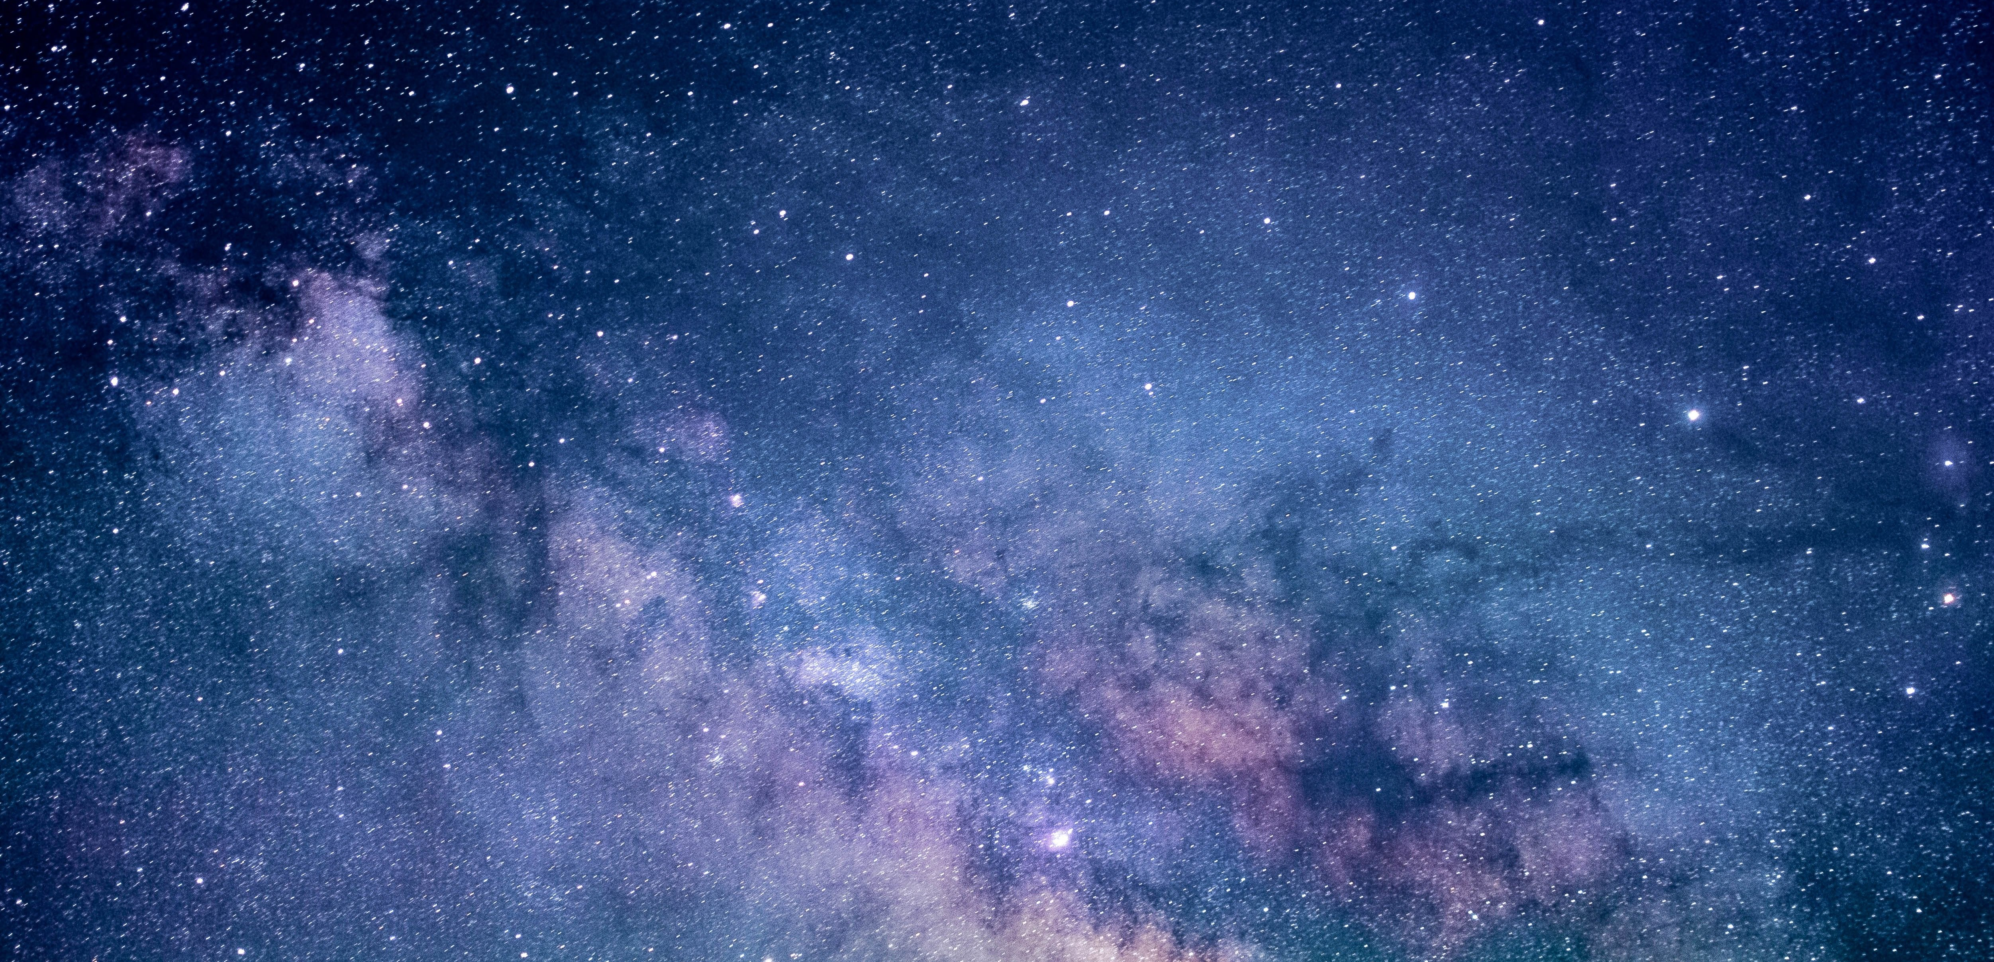

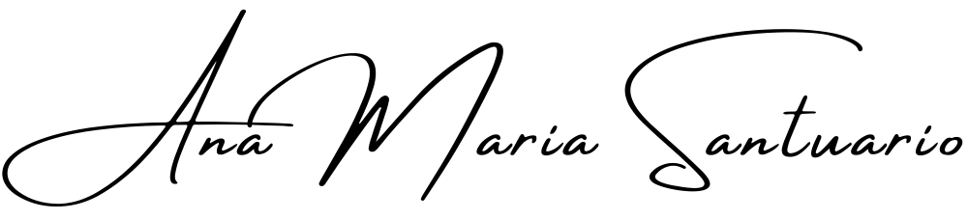
Self Care Continued…
The Self-Inquiry Series, with,
A contemplative approach to decision making and deciding on a direction for your navigation… especially when it comes to food.
Workshop 005 of the series, Self-Inquiry for the Modern Age.
https://anamaria.org/self-inquiry-for-the-modern-age/ ©Ana Maria Santuario 2023.

Slide 2
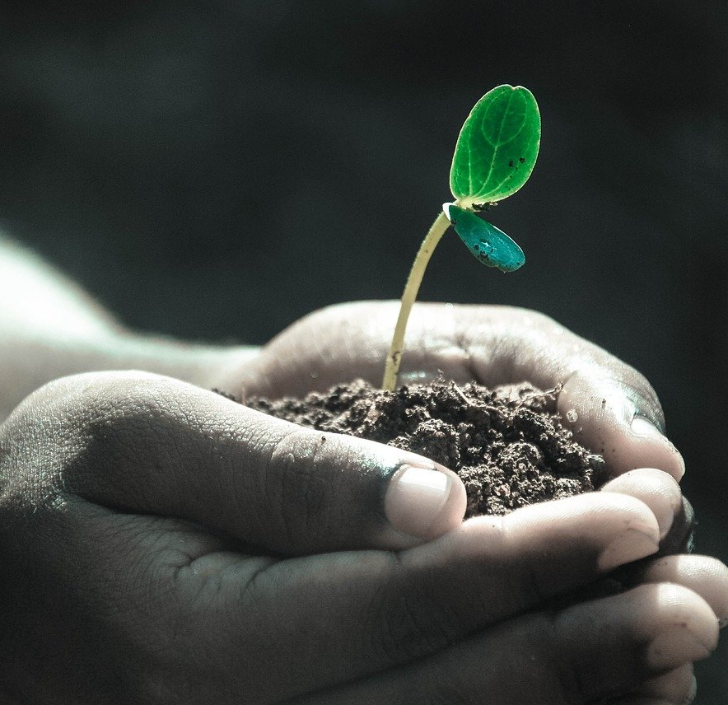
Things to explore in weeks to come…
Food
Words and their stories
Physical activity and stretching
Social activities
Loving life as a hobby
Staying centred
Staying enough
© Ana Maria Santuario

Slide 3
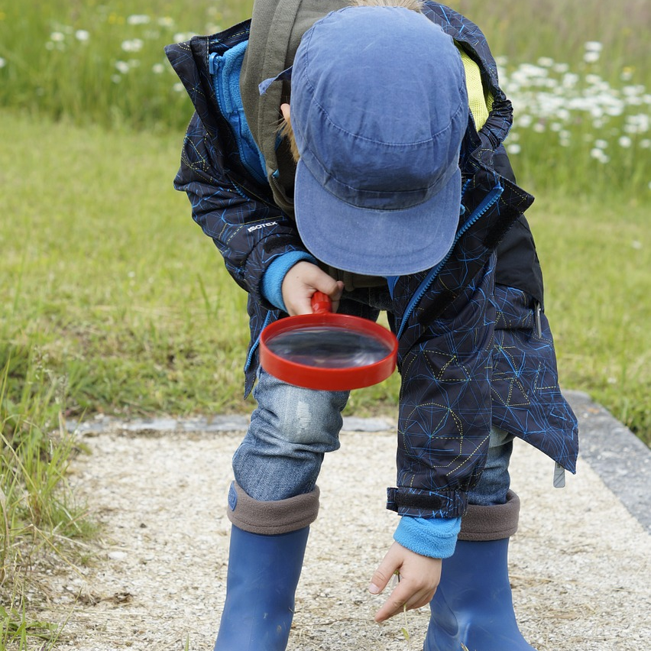
Questions or answers?
In life, you are commonly told things that you believe because something seems to resonate. But there is always more to learn, know and use, by way of applying this information to your world you can improve your own life and wellbeing. Do remember that what you know will always become challengeable, if you allow for it to be so.
If you believe each fad diet will enrich your world and solve your underlying compulsive eating issue, you are wrong. It may become a band aid solution, but there’s always something deeper at work with food patterns, since they are, at their core, a mind and body pattern intertwined and informed by years of life and programming.
Time was you’d be programmed by your immediate community, a world simpler, easier to digest and adapt to. Not a world of confusing information and silly rules, like calorie counting and 5 a day and protein, protein, protein!
These rules are gimmicks, stories told by those in the process of making money from the tales that they tell.
© Ana Maria Santuario

Slide 4
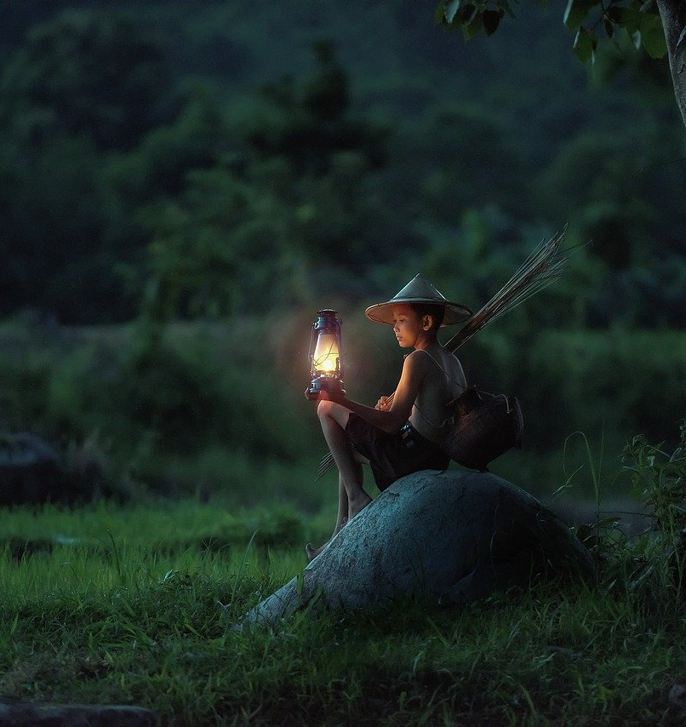
Back in the day!
To travel back in time all a person needs to do is travel to some place strange, beautiful and different. A far away land can become the very image of time travel when you allow yourself to fully envision this time and space as what it is… an alternate reality… and nothing to do with you or your judgements, views and opinions!
When I travel this world, I am in awe and live in wonderment of its delights, of its species and varying information. I see its stories and love each one. I do dream of a better world, since we all know it can and will exist in time, a world where community wins, and our core values are upheld as a humanity. A world of a little less me and a little more of us.
The ‘developed world’ thinks itself magic and advancement the key to joy and success, yet a ‘developing world’ speaks of our natural habits and habitats, and is more aligned with a reality I feel comfortable with and connected to. Less is always more to a family who know that love is the real treasure, and that nothing is worth the sacrificing of this one most important thing.
Something in me yearns for simpler. Honesty is relied upon within smaller communities and tribal mentalities speak of love, heart, social connection, as well as of a connection to this mother we’re all born from – the earth.
Spirit seems to have a place in each corner of the world too, such as it has for millennia and beyond. We are not as clever as we think, especially when we begin to deny our natural way of life in favour of things really not working for us… Let’s begin by looking at the dietary requirements of our kind.
© Ana Maria Santuario

Slide 5
The word DIET!
What a god-awful word! A word once defining a need to eat and sustain life, as it still does for every other living animal, insect and life form on this planet. Yet diet has become a word to fear, a discipline, a victimised attempt to control your weight gain by denying your right to enjoy your own world and all life around you.
Don’t get me wrong, I love a salad, but I also really enjoy ice cream and cake. I thrive when I east leafy greens and drink smoothies and home-made juice, but I also love a cheeseburger, occasionally (it can play on my gut, but when my world within calls for iron and other meaty nutrition, I heed its call).
Balanced diet is a speedy and safer replacement phrase for you to adopt… BALANCED DIET… say it with me… BALANCED DIET, BALANCED DIET, BALANCED DIET. Letting go of these diet fads, of starvation and deprivation makes way for a safer planet, a leaner planet, and focuses your energy on the right place to seek change – within.
© Ana Maria Santuario

Slide 6
To rid yourself of the shame of becoming weighty
If you are carrying weight look at why – are you eating enough to be this big? If not, get yourself to the doctor's surgery and have some tests done. Staff will sometimes deny your reality, since books tell them what’s wrong with you; but sometimes an energetic block CAN bring on things such as water retention, cystic conditions, such as polyps, and cause ulcers or other ailments.
Stress impacts your body oh-so-much and it is the first place to seek change if you are unwell. Food can help bring you back to balance and heal many things, but if you keep the toxins running into your energy stream, be they of air, earth or ether (aka – stress), you will become polluted energetically. The best course of action is to avoid polluting yourself at all. Stay safe, stay clean.
What goes in, must come out! And when you deny the reality of your overworked stressful self, you deny what really matters in life, your health and happiness (we return to happiness later, since no one can become perpetually happy, but it is time spent well and feeling good that we equate with this notion of being happy). Your life is only ever in your own hands… own it!
There is a reason you overeat, if you do, and its likely attached to three things; emotions; energy; and processed foods. Rarely will somebody gorge on healthy organic homemade meals, since it feeds nothing of the overeating little monster in your mind-body, which likes other things… There is a way to change yourself, but it will take time, diligence and compassionate acceptance.
© Ana Maria Santuario

Slide 7
Let’s look at these please: Emotions!
Emotions influence where you reach to fill a void, to numb a sensation of sadness, or to abuse yourself with harmful choices. Cycles and patterns are a complex facet of our existence and one not easily resolved, if it were, there would be no evolution of Keto, Paleo, Atkins or Juice Fasts, there’d just be THE WAY! Sad thing is, the way is already known, just forgotten… garden grown veggies, tree grown fruits, organically reared and raised meats! It’s the toxic chemical rubbish that has your system all over the place!
Please seek help for this element of yourself if it burdens and troubles you. If you feel hopeless, only to revisit failure after failure of a diet fad, do know that change comes with THE RIGHT ACTIONS, based in informed, researched content and knowledge worth listening to. I will attach a link to the proper information at the end of this webinar, since you deserve to know what you need, especially if no one even tried to tell you as a child.
You’re figuring this all out as you go, as I have done, and there is no one size for all solution, there is just knowledge, and how you come to use it will always be up to your own body and mind. Let’s go into it more later, since I want to get cracking… we’re heading to new and different places, so let yourself lean into this change, let yourself become yourself right now, eat a cookie, drink a soda, just don’t do it all day long and forever. But for right now, go easy on yourself… there is no overnight change I can promise, because it DOES NOT EXIST, and anybody who lies and sells you their speedy solution is making money off your vulnerability and honest need for support.
© Ana Maria Santuario

Slide 8
Let’s look at these please: Energy!
You are energy, anyone ever tell you that? That you’re made up of lovely vibrating energetic matter and that you likely have an energetic blueprint. For example, because simplicity is key here, we don’t all need to become physicists, we’ll look at love…
Love is a thing elusive of definition, yet we accept that it exists; what makes you attracted to a person you barely know, and repelled by another? Simply put – it’s all down to energy. Like magnets, we pull into our sphere of life things we don’t enjoy when our energy magnetises them… so as an extension of this example, a woman unloved in childhood brings into her sphere of life a loveless marriage and emotional abuse for years on end, such as her energy was programmed to accept as love.
Now flip this to your relationship with food; what were you fed as a child? Beautiful home cooked meals with nothing but love inside them. When I say this I mean the love of life… nature itself feeds us, unless you’re fed by humankind who have invented all kinds of rubbish to poison you and make you sick (enter pharmaceuticals – a debate for another day, but your awareness of these things is key if you are to free your mind-body from the mass manipulation and programming we have all become subjected to).
Who fed your growing body – mother earth – or humankind’s money makers? Just look at McDonalds for crying out loud! Why is it still standing, with all that we know? And why are happy meals called happy meals when they give nothing but a life of pain and suffering if you’re unfortunate enough to have ill-willed parents who feed you such rubbish and claim it to be ‘a treat!’
If your energy craves particular substances and foods it is not your fault, you’re likely craving what you are in energetic vibration.
© Ana Maria Santuario

Slide 9
Energy Alignment! Continued…
Who you are now is not your fault or of your making, and change can be harder for some than others, don’t blame yourself, it means your energetic alignment is stubborn, it means you’re here learning harder lessons and that practicing compassion for yourself will become key. Who knows, maybe you come to advocate the end of Maccy D’s. Maybe you rid the school canteens of junk food. Wherever your path leads to, you’re here walking it with purpose, just let it reveal itself in time, even if the purpose is to discover life is great and you’re pleased to be here living it. What a great reason to live life well – to simply enjoy it! Not to squeeze into the new jeans you bought a size too small, or to become a super model, or famous movie star, but to live well. Can this become your version of enough?
Binge eating is an energetic experience, you get a wave of craving, open your mouth and release some form of tension (temporarily) by putting stuff inside it that alerts your mind-body - there’s a whole complex experience going on… perhaps a nicer experience than you were living a millisecond before the food entered the equation. This tasty treat sends signals all round your physiological system and tells you that you feel something like better. Then the self loathing enters and you regret the mouthfuls of whatever chosen vice it was that you used to quench said craving... Or to numb said energetic happening – aka, emotion!
Then you likely go on to live this cycle again and again. A cycle on repeat is what overeaters live (I was one so I blame and judge you not), but it is hard to end this cycle without the right information, and perhaps a little support from others. Living in a house of over eaters will do nothing for your own discipline. I don’t buy the food and thus do not eat it. My partner, on the other hand, does buy it, and when he does I find the challenge to say no resurfaces.
It’s just in my energy… a story of need and want, one that I manage with mindful practices, learning to see the reaction internally rather than live it externally is key… now I never live the story earning the weight gain… instead, I practice seeing the story, which allows any discomfort to arise and pass… something that becomes easier in time.
© Ana Maria Santuario

Slide 10

“Whatever you’re numbing, it’s waiting to be seen and acknowledged, by smothering it with whatever vice you have adopted you hold onto the story keeping you stuck. Seeing your stories is no easy thing and I am not lightening your load, I am perhaps touching on a point in you that’s difficult to see. Leave it there if its easier for now, when you’re ready… dig in… to yourself, less of the food.”
-Ana Maria, 2021
© Ana Maria Santuario

Slide 11
Let’s look at these please: Processed Foods…
Processed foods have been changed, modified and sustained for far too long to have anything remotely resembling a life-force still residing in them.
Processed foods kill you slowly, end of story. Life breathes life… death breathes death!
It doesn’t matter how simple your diet is, nor how rich in nutrient variety, what matters is the quality of life being invited in by your body.
Look at those living in India, or remote mountains in China, or within little Italian villages, those who may have eaten a similar diet for each day of their life; those going on to live well beyond the years of a white-westerner living on processed garbage, as they supplement ill-health with processed vitamins, or band-aid solutions and fad dieting regimes.
Living well means living in harmony with your surroundings. A banana doesn’t grow in England, not naturally at least, should the English have it on their plate?
We are a complex creature, and you don’t see animals like lions suddenly eating lettuce. I just wonder about it all… for the answers lay with science, science I have yet to delve into and fully comprehend.
© Ana Maria Santuario

Slide 12

“I never claim to know it all, I only claim my right to think about it all! Come join me!”
-Ana Maria, 2021
© Ana Maria Santuario

Slide 13
Processed Foods… Continued…
Processed foods put something unnatural into your natural form. You are born of nature and light, and something dark resides in deathly food that has already died somehow.
Life is vibrating, changing and clinging to itself. Once you start eating your way to death, you have become a lower vibrational being, you have nothing inside of your lifeless body left to invigorate your world, not within nor without… The food you eat becomes you, quite literally; and perhaps, as a side effect – becomes the life you’re able to live too (for the most part – barring the role played in genetically inherited conditions and other such predetermining life factors – many of which are becoming more manageable with healthy, well designed diets).
For thousands of years, we worshipped the sun, the moon and stars, we worshipped the earth and her nutritious life giving ways… we stole nothing of life that was not needed and had not invented things to destroy our ecosystems… This came in time, and it is way of the world because of human greed.
Today I saw a photograph of the earliest record of tree huggers (Chipko Movement, India), they were saving forests from deforestation – saving life! Now that we are far removed from our natural habitat, as a rule, the way we resist has to change… Green worlds destroyed… and now our green bodies along with them! How do we come to stand together on this one?
The world of the mother is the world that I yearn for, the world of harmonised living, of only taking enough, of becoming life because its all you were born to be… not a doctor, or a famer, or soothsayer, just a life happening in the way it was designed.
But now your design is all messed up, with poor education platforms, with nuisance chemists pretending to now how your body works, with advertisers selling you the answers to questions and problems they themselves created.
You are life… stop eating the mini-deaths ‘they’ design to keep you in a state of perpetual decline and decay…
© Ana Maria Santuario

Slide 14
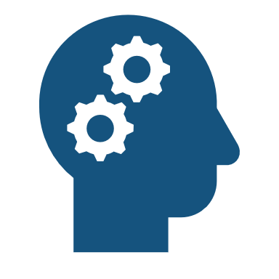
“Live until you die and stop dying a slow death… it makes no sense to a reasoned and free mind.”
- Ana Maria, 2021.
© Ana Maria Santuario

Slide 15
FOOD - Let’s get the story straight!
Food is energy.
Food fuels your life.
Food heals illness and prevents disease.
Food is not a toxic chemical compound, this is poisonous and WILL make you function less than optimally.
5 A DAY is no solution to a healthy lifestyle… it’s some hyped government target designed to help their image of protecting life instead of systematically destroying yours, mine AND THE KIDS’.
Food is grown, reared and slaughtered. Food is picked, plucked and harvested… it is not made in a laboratory.
Food is life designed to provide you with life… life giving, life enhancing, life becoming life… what a beautiful story to tell instead of this one size fits all plate of perfect health, which does not and will never exist!
© Ana Maria Santuario

Slide 16
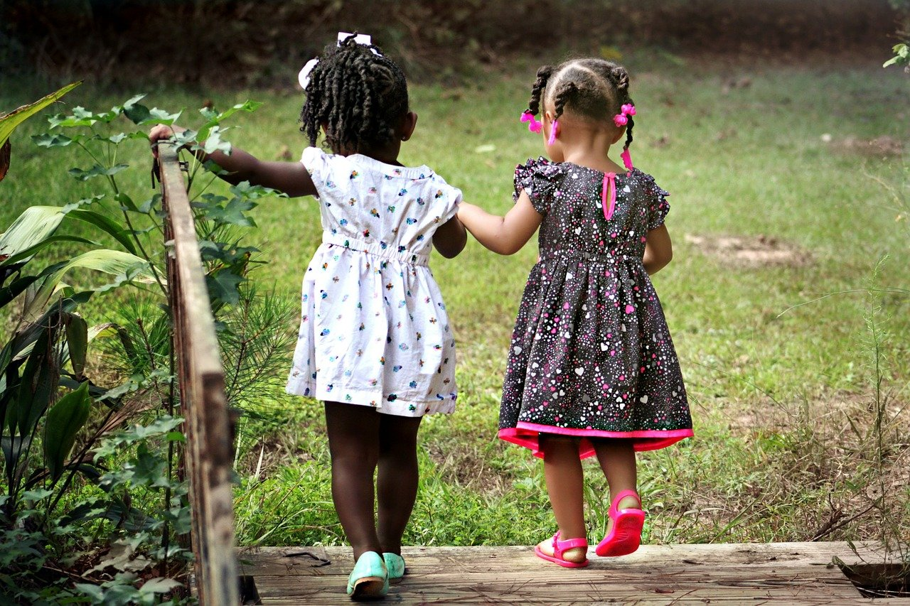
Love yourself as though you are loving them... In other words… be gentle, be kind, be safe.
© Ana Maria Santuario

Slide 17
“The pressure that you place on yourself is the reason you will fail… slow and steady, be gentle with yourself. Any real change, internalised change, takes time, patience and a whole lot of self-acceptance and love. Help from other sources, such as this platform, a therapist, a friend or lover, can help too… They can never do the work for you, but simply feeling loved as you come is all a person needs before finding the space to become something new, in time.”
- Ana Maria, 2021.
© Ana Maria Santuario

Slide 18
The words that we use…
Words are used to tell stories, always have been, images too! We have a knack for pretending we know what’s happening within and around us and we use collected phrases and concepts to harvest experience and turn it into the tales we tell ourselves, the world and the world’s children. A life in narrative is what we all live.
The words that you use daily matter; the way you speak about the world inside of you matters; the way you see yourself matters greatly and determines a lot about how you feel, picture yourself, and even your children (should you have any).
Let’s look at the word HEALTH next…since we attach a very many stories to this one word.
© Ana Maria Santuario

Slide 19
HEALTHY TO YOU, IS NOT HEALTHY TO ME!
Where did we go so wrong? When did we believe that the images we seek out in ourselves were close to resembling healthy at their heart? A tight buttock, a thin thigh, a flat stomach… are they healthy? Or are they ego and vanity shaping itself to another’s image of perfection? Are they healthy of mind? Once you realise this is where true health is determined you become freer, less reliant on external validation, and content with what is, instead of chasing an alternative that may very well be an illusion.
Are healthy people always looking the same in life? Or can a wobbly butt perhaps become the new healthy, since that wobbly buttock stretches, it walks everywhere, it sits comfortably on a bicycle when it wants to, it enjoys lettuce and cake, it likes to feel soft and supple, when touched by another it feels good to handle…
That softness of that particular butt has nothing unhealthy about it, not compared to a gruelling lifestyle of pressure and stress, that which results in a finely honed slab of concrete as a buttock…
Get your butt out now… look at it… it will speak volumes about yourself… not the butt itself, but the stories your mind is about to tell about it all…
© Ana Maria Santuario

Slide 20
This is a learning curve…
The curves of your body are beautiful… sculptors of old knew this about the female form… Women were never sculpted to the athletic perfection of men… They were full faced, softer in form, had supple breasts, and bodies that grew beautifully into the likeness of an angelic mother, less often, a sex goddess.
The female form is not so much celebrated, as it is shaped to fit a fantasy – a man’s too I suppose, with beefed up steroid enhanced muscles… or a protein shake lifestyle. Whatever supplement or growth hormone, or stimulation of growth you go for, one things for certain – it ain’t so natural! (Most of the time).
I know there’s a world without the pressure of perfection because it’s the world that I live in… and it’s so much nicer liking my body than hating it (I’ve lived both stories now, multiple times… and what determines whether I feel good? Why, the story I’m telling about it all!).
© Ana Maria Santuario

Slide 21
Mind noise = madness!
Have you seen what young females and males are doing to their skin – plumping it up to look like some illusion of perfect? It looks strange to see a face unnaturally full of something it shouldn’t be. Just as fake breasts are not natural, neither are fake lips, fake butts and even now, fake calves, cheeks, hair (extensions or plugs), fake teeth - even when yours are perfectly pearly and chew food LIKE THEY ARE MEANT TO!
We have become a cosmetic project instead of a life-given form of magic!
Your body is built to make love, to swim, to dance and have fun times! It’s made to sing songs, roll down a hill in the snow and make fun with itself. Kids do this better than most, those who perform the arts come perhaps a close second…
Only a hatred of oneself causes a person to alter their body into an unnatural state… only a mind going mad with illusion pays for poison to be installed into their perfectly designed body…
If you want to change yourself that badly, please seek support and change your inside world, less of the outside stuff please – it solves nothing, which is proved by the drastic transformations of those who end up looking unwell, disfigured… and still can’t stop trying to attain some image of perfection that doesn’t really exist.
There’s nothing wrong with normal, without makeup you’d be surprised how normal we all are!
© Ana Maria Santuario

Slide 22
No Judgement!
I do not judge, I observe a crazy world and its inhabitants. I cannot reasonably fathom a mother or father wishing their child to look into the mirror and want to inject Botox by the age of 33, which is why we must start re-educating our young before they are victims of modern society.
I cannot compare my world to another's and ask them to blame themselves for such an actuality, neither can I blame their parents who had no idea the world would speedily become what it has – a self-hating machine, churning up inward loathing and an internal comparison compass, pointing towards things unreal, unachievable, and unsafe!
We need to slow down this wheel of motion heading towards self destruct… we need to learn how fragile our minds are and come to protect ourselves from harm caused by the media, social image content, and a life of them and other… a life of wanting to dream up a reality to spend a short lifetime chasing.
© Ana Maria Santuario

Slide 23
Reality Checks!
We need to reality check our youngsters, to teach them that there one constant home, aka, their body, is something to revel in, to treasure and cherish beyond anything else in life. Teach them it will house them from a storm, shelter them from a workplace fallout and inform them when they need to make safe their situations and life.
The body informs our worldly pursuits, gives us information every minute of everyday – hairs stand on end, danger… tummy aching – hunger, too much chocolate or other processed foods, or perhaps too much stress.
What you put in your body should run as follows… as a foundational rule – water, ice cream, properly churned with organic ingredients, butter, without the chemicals (old-school style), fruits and vegetables, perhaps juiced, perhaps in smoothies, perhaps whole and dipped in peanut butter! There are no rules to how delicious a healthy thing can be, it all lies in the making of said food/meal, and how it comes to energise and impact your entire sense of felt life!
The wrong things are ALWAYS – toxic chemical compounds, anything made in a laboratory, anything made to speed up your metabolism or reduce your calorie intake – any quick fix supplement intended to make an unnatural process possible in your very naturally occurring phenomenon of a body.
© Ana Maria Santuario

Slide 24
Time for Celebrations…
You are alive and kicking! You may very well live a long and healthy life when you choose to make the right decisions for yourself and those around you.
Becoming a parent is a task like no other, and I suggest learning to take excellent care of your own mind-body first, before standing up to teach another human being how to live life, make sure your lessons are worth the effort of teaching them.
Don’t be the parent who sits in front of the tv on the couch binge eating and punishes their young by way of handing down such a habit, they deserve better, and so do you! It doesn’t mean to say you must beat yourself up, but perhaps do this out of sight and gift them with freedom from inheriting your own unhealthy patterns.
Just like smoking, revealing you smoke permits a youngster to do so, smoke in hiding (not because of shame, but an awareness of being a role model). Protect children and young people from their greatest risk of decline in life – yourself, if this indeed your situation.
I am not judging, just speaking for those without the voice to ask you to become the right kind of role model, the role model every child deserves – a healthy one.
© Ana Maria Santuario

Slide 25
NEXT TIME
We continue looking to yourself in new and interesting ways throughout the Self-Inquiry Series and unpick this great wave and pandemic of body image mania. To love yourself requires more than self care, it requires self-acceptance, which is a very different thing, and much harder as a point of reflection.
Check out the self care section of The Self-Help Library for more lifestyle change support and practical resources. Take your time, rushing can lead to crashing and burning out, devote yourself to the journey, not the outcome.
Workshop 005 of the series, Self-Inquiry for the Modern Age. https://anamaria.org/self-inquiry-for-the-modern-age/ ©Ana Maria Santuario 2023.

