Slide 1
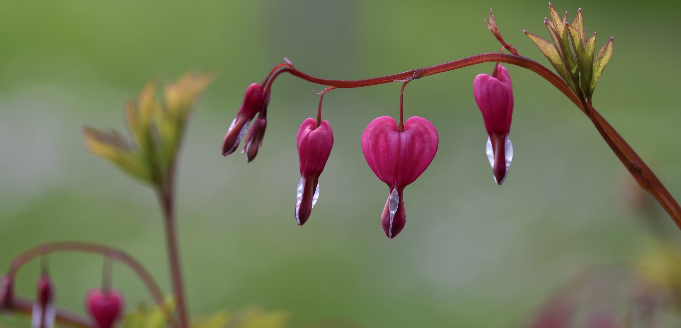

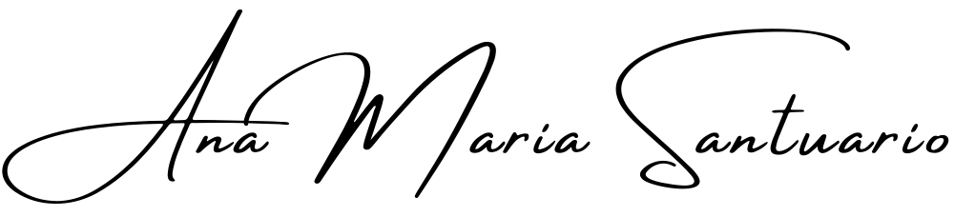
What Am I?
The Self-Inquiry Series, with,
Bursting your bubble is what self-inquiry is all about. By pretending you know things you create a cage, herein lay keys to your inward sense of freedom, love, peace and joy.
Workshop 006 of the series, Self-Inquiry for the Modern Age.
https://anamaria.org/self-inquiry-for-the-modern-age/ ©Ana Maria Santuario 2023.

Slide 2
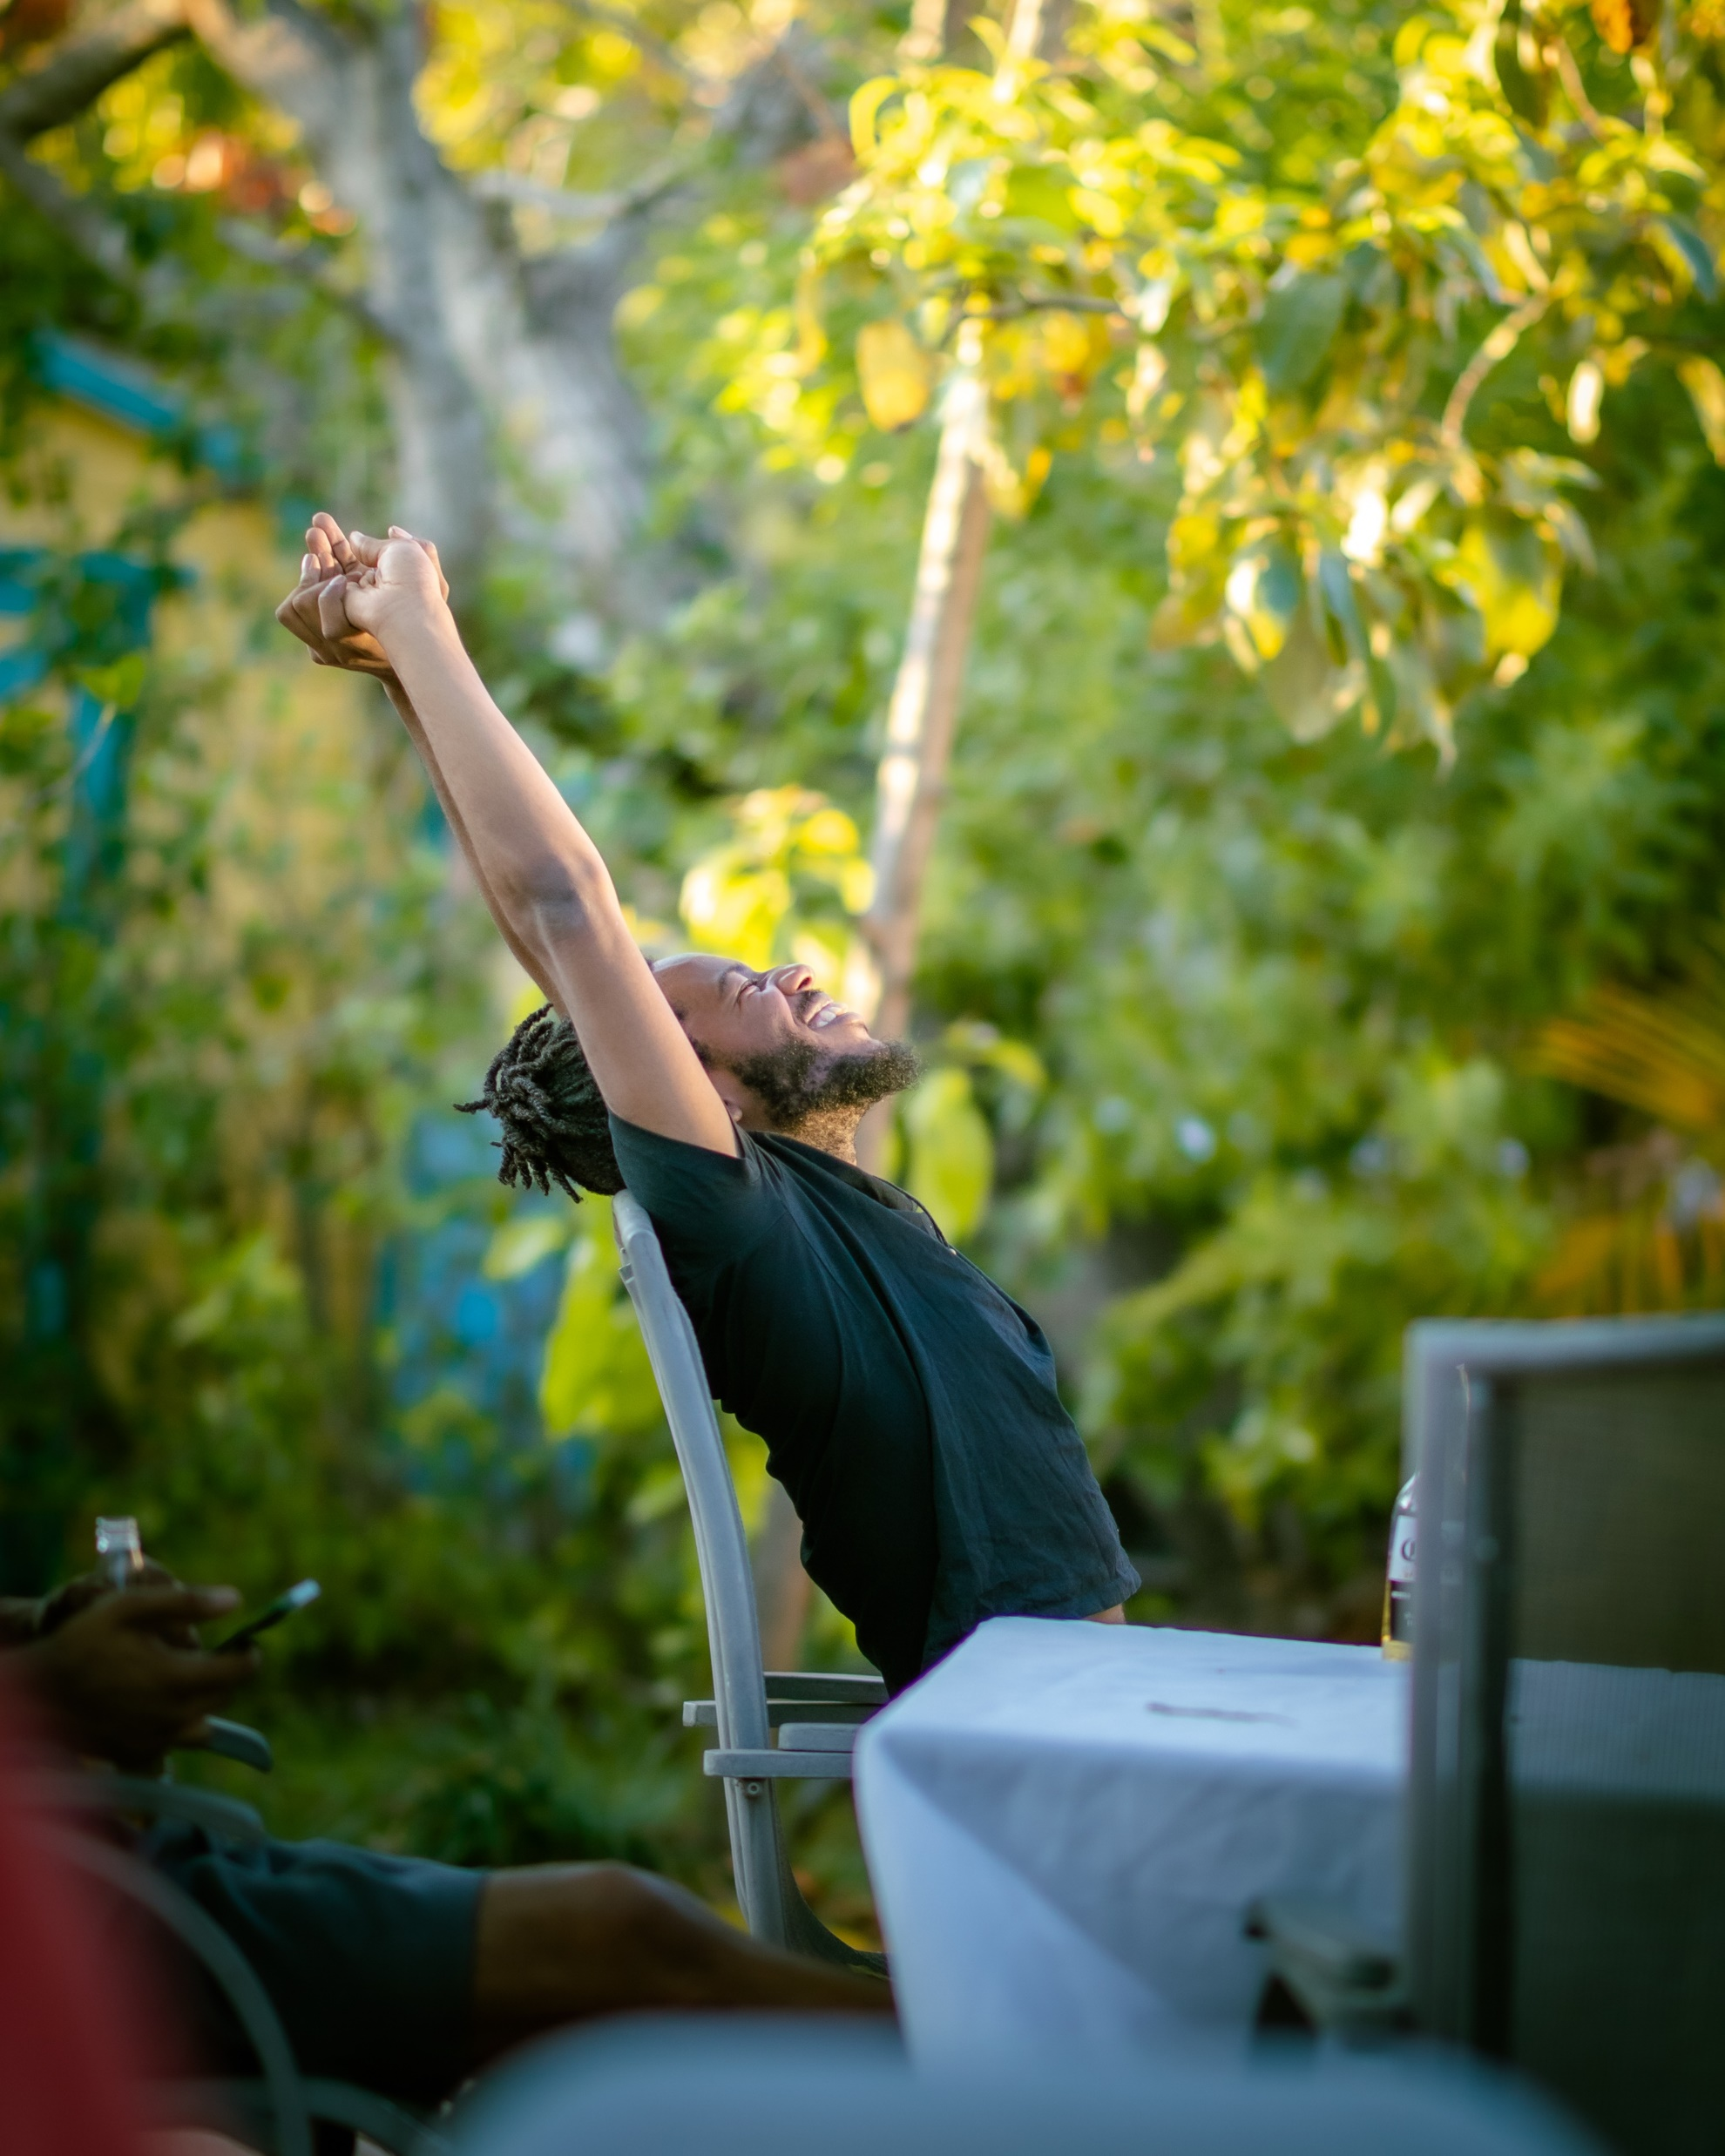
There is a world within you… can you see it?
Only by looking within can you come to know what you are made of… joy, fear, sadness, rage… sadly, for many of you the answer is pain… we are all made up of suffering spots, things we avoid touching upon, aspects of self we ignore, deny and shroud in shame. When you can commit to self-compassion and self-acceptance as a way of life this all becomes far smoother as a lifestyle. Self-inquiry is no easy feat and it is a modern agenda. For it to be accepted, pain must be respected as real, therapy as required for some, peace as being found in isolation for others. To self-inquire with success you MUST come to do what you need at any given time and stop apologizing for it!
© Ana Maria Santuario

Slide 3
What am I, or, WHO am I?
Am I energy? Am I stories? Am I my trauma, shame and pain? Am I my thoughts? Am I life? All questions worth asking lead only to more questions. The only answer to, what am I?, that gave me a feeling of contentedness is, ‘I am love.’ But what does that mean?
To know you are love is one thing, to act as love is something far beyond reason, comprehension or knowing. For a person to know they are love they must simply decide to become it again. Life and this world turns you towards fear from the day you arrive in the womb, be that because your parents fight, perhaps they watch scary films, or maybe the mother is dissociated and numb and feels very little at all, and thus, cannot detect danger or keep you safe from it. Maybe she is the danger.
There is an increasing number of children with escalating behaviour problems, is it because they have absorbed more pain than they can safely contain and manage from the t.v. and video games? How can we ignore that as being the real culprit of mental health decline, and so, physical chronic illness too?
Perhaps chemical garbage food is also to blame; for where you can accept that you are energy, and that some food offers love to your form and mind, while other offers torture, poison and pain, you can come to see that where you ARE love, it means you live in a way that shows you love yourself freely and without doubt, question or confusion.
© Ana Maria Santuario

Slide 4
Are you able to feel angry?
Rage and hate are other ‘Aspects of The Self’ the world determines as wrong, yet these characteristics are glorified and celebrated in Hollywood film and BBC series. How can something be used for entertainment yet shunned as a societal aspect of change and empowerment?
Hatred can be traced back to its origins when a person takes time to follow the threads back in time… sometimes hatred was fed to a child by their parents, for others, it accumulated slowly while they played the martyr and became a metaphorical punching bag for others’ bad and disrespectful behaviours… to hate is to be provided very vital information by your mind and body. When interpreted correctly and used to make choices it can become a very useful thing indeed.
The same must be said for anger, rage more especially. When a mountain of anger has been left unattended to it becomes rage, rage is the accumulation of small moments of unprocessed anger, and perhaps even sadness. When a person is not allowed to feel what they feel, to express themselves clearly, rage manifests deep within and shows itself in various ways. For some, chronic illness is the way it comes to find release, for not everyone can find their way to noticing rage and releasing it through verbal strategies and/or other healing modalities.
© Ana Maria Santuario

Slide 5
Can you accept your body and what it can do?
Over time, as a body becomes full of ‘stuff’, it WILL release it in the ways that it knows how, which is what a mental health crisis looks like, when ‘stuff’ comes pouring out in the form of thoughts, reckless behaviours, substance misuse or abusive patterns (be that towards self or other). When too much pain comes up to be witnessed, acknowledged, ALLOWED, and respectfully encouraged to be healed, when a wound, not a scar, wakes up, it can even lead to suicide for some (when too much starts coming up and out and there is seemingly no way to navigate what feels like a sinking ship).
To feel pain takes practice, to learn to accept the body and what it can do means accepting EVERYTHING that sits inside of you as being a part of your whole!
You are a complicated and blessed machine of nature, one that has been designed to perfection, allowing this to become your main narrative, even in the depths of the deepest and most unbearable pains can bring you through to the other side of what we will call, ‘Waves of The Self’.
*Note, do seek help for yourself when required and as early as you can. To leave things like mental health unchecked results only in one thing… further decline. Crisis management resources are also coming to The Self-Help Library so you can head there when the time is right if you feel drawn to immediately helping yourself as a necessity to survive something coming up from your depths… you are not alone in this, no matter where you are with yourself.
© Ana Maria Santuario

Slide 6

So… Waves of The Self…
Conformity can be blamed for so much of our suffering… conforming to a ‘civilized society’ comes with many a covert oppression. We are wild at heart, a being made up of so much complex life… we can grieve, hate, love. We can cry, resent, feel jealousy and craft stories that make us come together, or divide. We weave together a world without ever knowing it is what we do constantly. We mostly become stuck in the web designed by others from a young age… and the webs change, as do we… with television, social media, ‘freedom’ of speech, equality narratives, gender role shifts, everything is different now, even compared to 50 years ago… and many are suffering profoundly because of this noisy, shameful, money grabbing, greedy-government decided world!
Poorly designed education systems can be blamed for a lot of ill-preparation for life. Little children feel freely and openly until they are INSTRUCTED not to, until they are forced to sit still, look, listen, regurgitate. They experience many of their little waves of life daily, laughing together, crying when they feel pain, feeling excited about learning, asking many whys, and they are very angry when they are subjected to something they feel innately is wrong. A little world of felt and perceived justice is where they dwell, but rare are the adults who help them find contenting resolutions, harmony and balance. Rare are the adults who see the wisdom of their responses to this ugly world and who respond with respect, patience and timely interactions (aren’t we always in too much of a rush to be anything else but dismissive of their whole experience?).
Very few adults raise kids to just be happy and free to express themselves, many create happy mirrors, reflection of themselves, for that is far easier than navigating the changes required to raise children well and safely. Far easier to rely on the superficial parent’s evening to reassure you of their security in the world, than anything concrete or real and observed by your own eyes!
© Ana Maria Santuario

Slide 7

How about YOUR waves of the self?
Don’t get me wrong, if you are a parent having an uncomfortable reaction right now, let that reaction be telling you something important – let this WAVE of stuff happening inside present you with vital information that can then go on to be utilized somehow. Maybe you have been neglecting something, or perhaps finding zero energy to carry out a daily task like cooking well… it could be anything that now presents as anger, resistance, annoyance… but whatever it is, own it, for I might be stirring it, yet it is yours to own!
I cannot know what waves live within you, only you can, only you can work towards resolving what presently ails you and conflicts with any contented and regularly told lies you tell yourself. The shame of it is, you will likely run, that is natural, to dive into our faults, fears, and failings is scary, too scary for most, for when you jump into that stuff it impacts your entire world, the one inside, and thus, outside! So, no judgement from me if you shut this all down now. Forgive yourself, be content that you tried, and come back again when you feel more able and ready.
Just as the world makes you what you are, it does the same for the kids, and it did the same for our elders. To cast blame is nonsensical when you widen your lens of perception and take in history, millennia even, of ignorance being discarded with discovery and re-education. Time will change all and it doesn’t have to be your job to change it! Nobody tells you that; you often hear that YOU are responsible for climate change, for polluted oceans and empty dead forests… YOU are responsible for it all because you live in the societies that use fossil fuels, paper, that sit on wooden furniture and use wooden pencils…
Look, if we could stop it all tomorrow, we would, surely, right? But who has the answers? Scientists most likely, like the one who ran a car off potatoes decades ago, but who was silenced by government! Hint, hint… whose to blame?
© Ana Maria Santuario

Slide 8
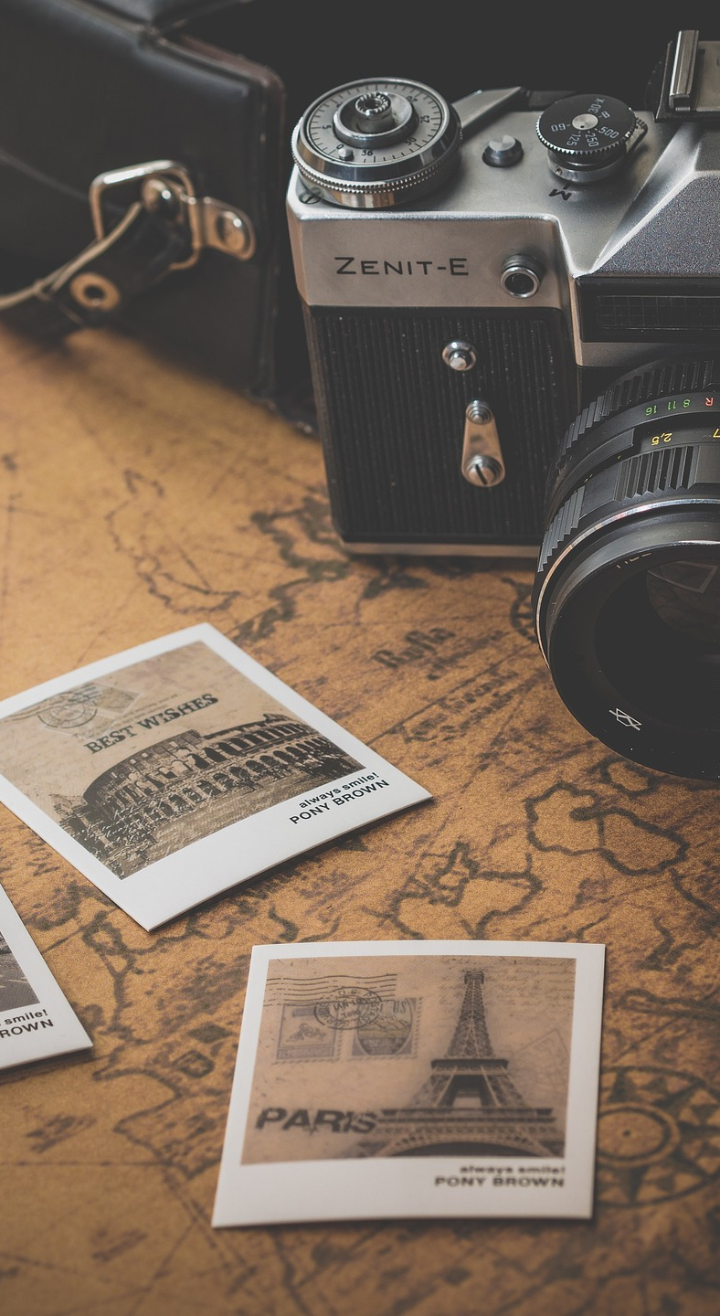
No kids? No Worries…
The world has so many stories, and thus, too many answers that make no sense… often, many answers to the same questions…
So, what are you, is a question met with many responses, perhaps list them now… What are you? A mother, a father, a single person, a doctor, a secretary, an angry person, a depressed person…
Are any of these true? Is a person a doctor before they qualify and practice as one? When you stop being depressed, is what you are still depression? No, therefore, you are not, and will never be anything the world labels you as.
Many people used to look at me, crossing the half-way mark between 30 and 40 years old, the dreaded ‘geriatric mother years’, and pity me. Haha… cross the line of 35 and you are suddenly geriatric by medical terms. These so-called friends, before I had children of my own, used to look at me with eyes that saw my shame, the shame they imagined existed. But I had none…
I created an exercise for myself one day, when their eyes started trying to become my own, when my mind started chattering away, ‘My god, I’m out of time. I will never meet someone in time. I’ll be an old mum, I don’t want to be an old mum. Maybe I shouldn’t be a mum anyway, still being in PTSD recovery, shame, I’d have made a great mum. Maybe I will adopt, I can do that at any age.’
People even mentioned freezing eggs and artificial insemination to me, despite me not even caring much at that point whether I’d start a family or not. And as far as I was concerned, I was NEVER bringing a child into a one-woman family, it was not something I would find peace with, filling a hole in my life by inserting a child into an empty, family-less home. People have their opinions, people forced their view on me with, ‘Yeah, but divorced families have one parent in the home.’ ‘Yeah, but some parents die and the kids are left with 1 anyway.’ The difference, for me at least, is that life CHOSE, in these cases, for the kids lives to become that story… but I would not, from fear, not when life still had time in it for something else, choose to burden myself with becoming a single mother with very few people around to love and support me as I did.
© Ana Maria Santuario

Slide 9

So, the exercise that freed me…
While the world told me what I SHOULD want and desire, I decided to CHOOSE for myself…
I started asking myself…
‘Would I want Pete and Cindy’s unhappy marriage? They hate one another most of the time, and are terrifying parents to their children and they cannot even see it. Or do I want what I have here in this moment?’
‘Do I wish for my life to look like Samantha’s and Mandy’s, sleeping in separate rooms, hating one another, looking at me with pity when all they are is resentful of having never followed through on a single dream that they had? Or do I want to drive across the USA solo and see more of the world before I start anything resembling of family? Do I still have a few dreams left to live?’
‘Do I want to be with someone who abuses me, or alone?’
‘Do I wish to be consumed with an unhealthy divorce settlement, trashing my ex-partner in court while the kids are ignored and argued over? Or can I embrace being a writer and having this blessed gift coursing through my mind, heart and fingertips?’
‘Would I want that fabulously spacious home, while working in a job I hate and that consumes every waking moment just to pay for it? Or will simple and happy suffice?’
Don’t get me wrong, I know more than enough people live in happy, healthy, balanced and harmonious family homes, full of love, generosity and kindness. My point is that those judging me, pitying me, causing my mind to flag up that something was missing, well, they had nothing, and I mean NOTHING that I saw as desirable or fundamental for my happiness to grow (inwards, always look inwards folks, it’s where the source of it all is).
When I played this game time after time, I saw myself relax, for the world may be trying to force me to want certain things, but when I stood content and appreciative of the present and who I was in it, I was free… both of the world and its stories.
© Ana Maria Santuario

Slide 10
Life shapes you…
So, what you are and how you experience life is very much determined by who raised you, where you are living, who you hang around with, what you have eaten and consumed from the environment; but more than this, it is reliant on your filters, those that make you who you are…
We all have ‘components of self’ presenting all the time… for some, a major filter interfering with quality of life could be insecurity. For another, greed (which comes from a lack of safety, a need to fill up externally something empty on the inside). Every part of this ‘you’ will be there because of your past, for history determines your present moments, always, unless you are a master of the self and a mindfulness queen (or king).
To be free of the past there is only one way forward, self-inquiry, a route leading to and through despair, depression, rage, internal torture, and wave after wave of ‘stuff’ flowing out of your energetic body and makeup of mind… To move THROUGH every layer of self as it arises for you to witness, bear, endure and release, is a chaotic, other-worldly experience. As soon as you enter the realms of self-dissection and self-analysis you leave this world behind for a better one, a purer one… one that may become your version of heaven on earth should you make it through any energetic garbage you keep throwing out and tossing back into the ether…
The trick is not to believe your own thoughts, not a single one. You are a drop in an ocean of oneness and matter very little except to yourself and those in your immediate environment (sometimes not even them). Harsh, but the reality is you don’t really matter much at all unless you become a feature of the whole, instead of the self. Some characters in the collective story do matter more, be they figureheads, people sent to stir conflict so that illusions can be dispelled, or perhaps a character of love sent to mirror how little of it there truly is in this fear-based world…
Rather than saying you don’t matter, I might now shift it to something far gentler and determine that you are simply less important than say, Princess Diana was, quite simply because she had a light to shine into humanity’s collective heart, a light that lives on like, ‘A Candle in The Wind’, as Elton John so eloquently and beautifully encapsulated at her funeral. None of you can claim to be important to orphans, the vulnerable, those in need of compassion and light, as she was. Make sense?
© Ana Maria Santuario

Slide 11
But my thoughts matter, right?
The only context in which your thoughts matter is with regard to your lived and daily experiences. Thoughts can hurt your time on the earth, or be the reason you are blessed with utter joy, love of life and self, and the ability to draw wisdom from pain… thoughts are your personality, the way you react and respond, they are what make you, you, so of course they matter, to you. But to everyone else, they are invisible, matter not unless you use them to do good (or bad, as many do too); for a thought is quite simply a passing cloud of stuff, stuff that is more than likely getting in your own way a lot of the time.
To believe a thought is to believe what the world tells you, for that is where most thoughts come from. Without language, without having been taught how to read, write and speak, would you think as you do? Doubtful, therefore, it is reasonable to determine that much of what you experience is processed through the filters of language (verbal and body), subconscious programming, and therefore, it is beyond your comprehension and recognition much of the time.
For example, as I continued to grow externally and break free of the cage of limitation that was self-loathing, self-doubt, insecurity and a lack of courage, I kept hearing this voice inside, it kept saying, ‘Be careful. Be careful. Be careful.’ Then slowly, as I kept moving forward anyway, when I did not let, ‘Be careful’, stop me, the voice changed to, ‘Stop caring. Stop caring. Stop caring.’ And when I stopped caring what others might think or feel, when I stopped regurgitating things I knew meant I had a place in this world, a familiar yet small one; when I stopped caring about the voice saying, ‘Be careful’, I knew I was free… not free of thoughts, but from believing them and letting them determine every step I was taking.
‘Be careful’, likely something left in body and mind from childhood… something no longer required, but that had likely been keeping me existing beneath imagined and subconscious threats all my life. Thoughts are information, only ever information, about who you are, where you may go in life, and can determine how you tend to suffer while stuck in a narrative of the world’s design, not your own…
© Ana Maria Santuario

Slide 12
Back to the question… what am I?
Are you the thoughts that you think?
Are you energetic garbage?
Are you a man or a woman?
Are you free or caged by your body and mind?
Is freedom real or imagined? Does the answer mean I can imagine I am free and simply become so?
Am I love? What is love? Is it action? Is it being? Is it energy?
Am I fear embodied?
Am I a creature of habit and unchanging thoughts and dreams?
Am I awake enough to see that I am a medley of life happening at every given moment, even as I sleep and dream and heal and breathe?
Am I life? Am I dying?
Am I okay with not knowing and throwing away every answer my MIND just determined as real?
So, what are you? Do you know? I sure hope not, since unknowning is like pulling at threads that unravel towards infinity until you become one with time, space, energy and light… Pretending to know will be your cage until you find the key to unlocking it, by stepping into fear and staying there until fear has no space left to grow and all you are is presence (aka, love).
© Ana Maria Santuario

Slide 13
Where to from here?
Pen Pal Service and
Self Support available at
ANAMARIA.ORG
PEN PAL SERVICE
Where you are serious about self-inquiry, which means you’ve made it through at least the first 6 of these contemplation PowerPoint workshops, you are welcome to apply to my Pen Pal Service. It costs you nothing, unless you choose to donate in exchange for the time, wisdom and light you receive. Money should not equate to awakening and opportunity, so I could not choose to charge a base-rate. Honesty-Box donations are my new solution to equality of opportunity in accessing everything that I design, do read more about that here.
Moreover, to be ready for the Pen Pal service one must have read, Faith, In Stories That Change, a book designed to poke and prod at perception of self and world. I do not claim to have all the answers, but I do speak my mind and from the heart too, a wonderful combination that has led to me existing in service of my audience. Without motive or reason, I am simply playing my part, the part chosen for me by divine intervention, not the world around me.
SELF-HELP LIBRARY
I am unable to help people across the globe with any specific or direct line of support, however, the path I have chosen to work with is resources creation and development. At Anamaria.org you will find much to support your journey with yourself, that which you can adapt and use in your own way, free of charge.
Workshop 006 of the series, Self-Inquiry for the Modern Age. https://anamaria.org/self-inquiry-for-the-modern-age/ ©Ana Maria Santuario 2023.

